Slide 1

SMART NAVIGATION SYSTEM FOR
VISUALLY IMPAIRED PERSON
2022 - 227
11/9/2022
1

Slide 2
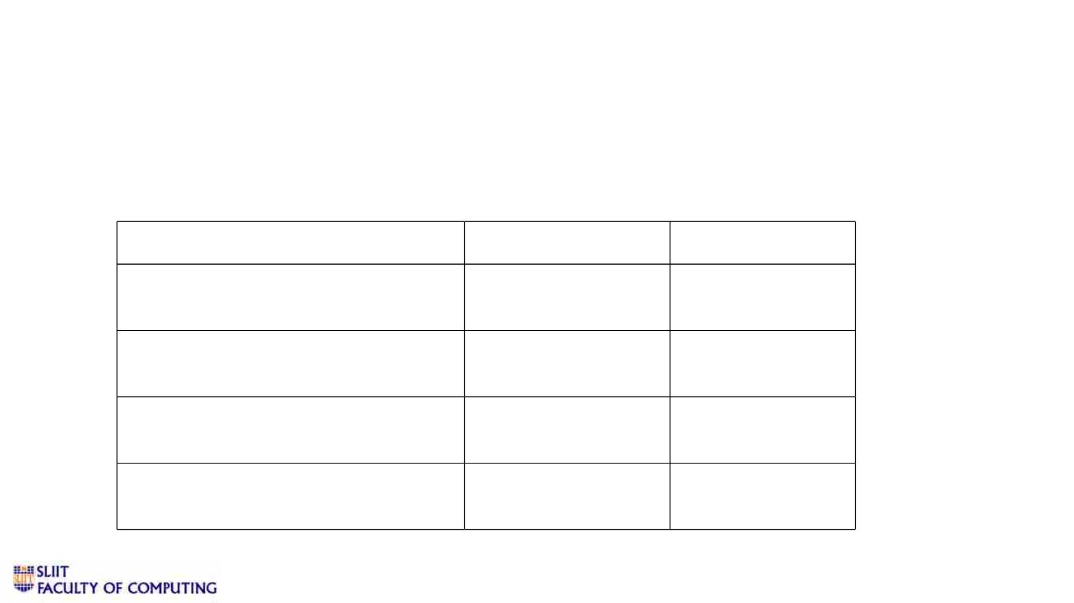
Supervisor -
Members
Ms. Sanjeevi Chandrasiri
Student Name
Student ID
Specialization
Jathusanan.E
IT 19049878
SE
W.R.J.M.Weragoda
Madushan.W.A
IT 19008424
IT 19042152
IT 19109190
SE
SE
SE
S.R.D.Sudaraka Keshara
11/9/2022
2

Slide 3

Overall Project Description
Ø We are implementing an Android Mobile Application which can be used as a
guide for those who are visually handicapped.
Ø Through our application for visually impaired people, we are attempting to
improve self-sufficiency.
Ø The key features that we intend to implement through our application are
household object detection, road sign detection, obstacle detection, and
relative face recognition.
Ø These features are going to be implemented with the help of image
processing and machine learning.
11/9/2022
3

Slide 4
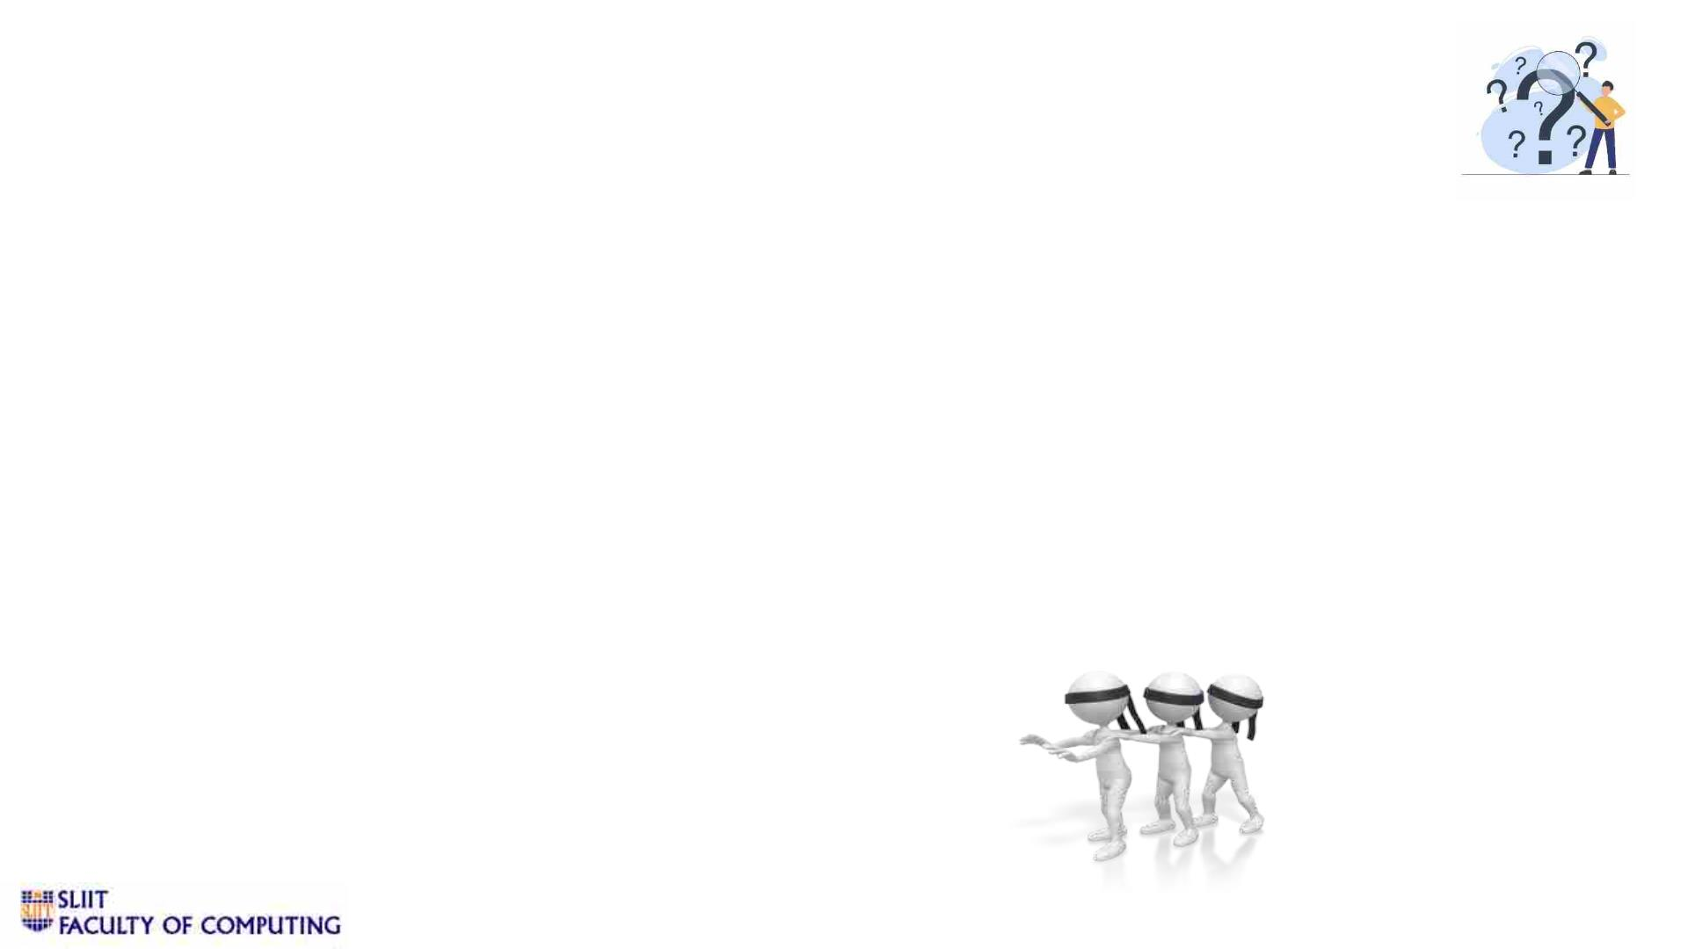
Research Problem
Ø The ability of visually impaired people to perceive information through their
eyesight is the first issue that has been found.
Ø They should challenge themselves daily to cope with their diminished vision in a
world where most people interpret their surroundings through vision.
Ø Finding household items, road signs, barriers in their route, and dealing with
relatives when traveling are their significant issues they confront throughout their
lives.
11/9/2022
4

Slide 5
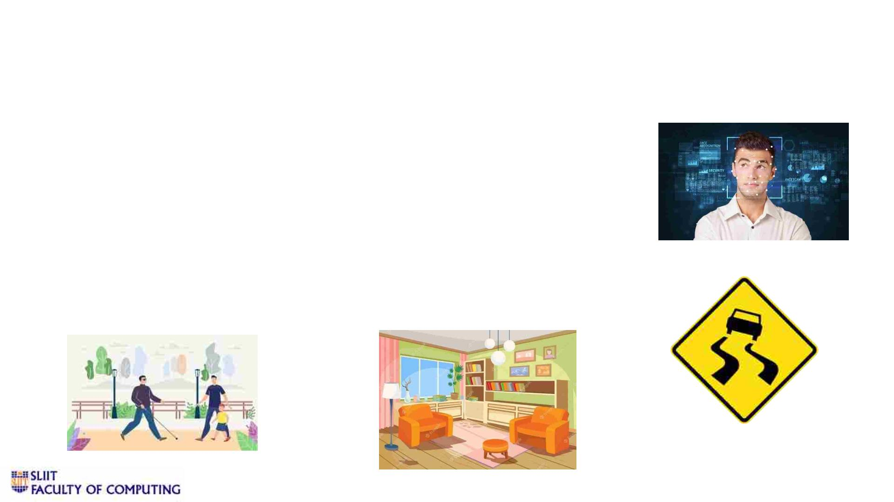
Research Objectives
Ø Making the household navigation easier for the visually impaired people.
Ø Smart obstacle detection when walking in the surroundings.
Ø Road Sign Detection when walking.
Ø Make Ease the detection of family, relatives and friends.
11/9/2022
5

Slide 6
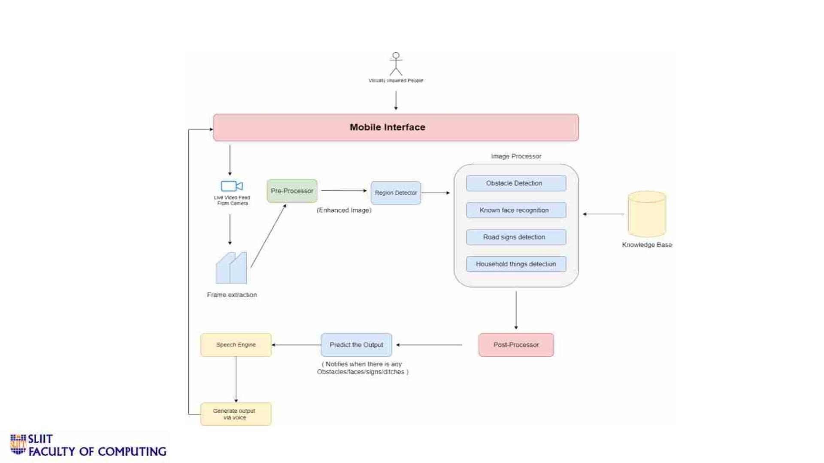
System Overview Diagram
11/9/2022
6

Slide 7
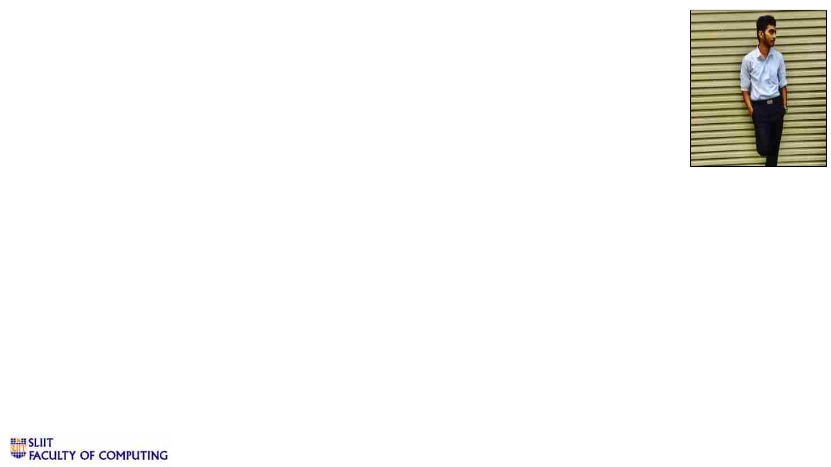
IT19049878 | JATHUSANAN.E
Software Engineering
IT19049878 | Jathusanan.E | 2022-227
11/9/2022
7

Slide 8

Introduction
v Background
Ø The eye is the most important sense organ in humans.
Ø For the visually impaired, self-sufficiency is not always possible.
Ø Braille is tremendously beneficial for identifying things and transmitting information, but it is still
limited by the high rate of illiteracy among the blind nowadays[1].
Ø For visually challenged people, everyday activities like safe navigation in a new indoor/outdoor
environment, unaided shopping, or just getting to a chosen location become extremely difficult [2].
Ø They require assistance to gain knowledge of an object in their environment without touching,
smelling, or hearing it.
IT19049878 | Jathusanan.E | 2022-227
11/9/2022
8

Slide 9

Ø There are numerous applications and technologies available for visually impaired people
to use in their daily lives.
Ø Devices
1. Mobility Assistance Robot[3]
2. SCADA SYSTEMS[4,5]
3. Stick
4. Optical sensors (RGB cameras and GPS )
Ø Software Applications
1. KNFB Reader - Reading text aloud
2. LookTel - Identifying money
3. Color Id - Detecting colors
IT19049878 | Jathusanan.E | 2022-227
11/9/2022
9

Slide 10
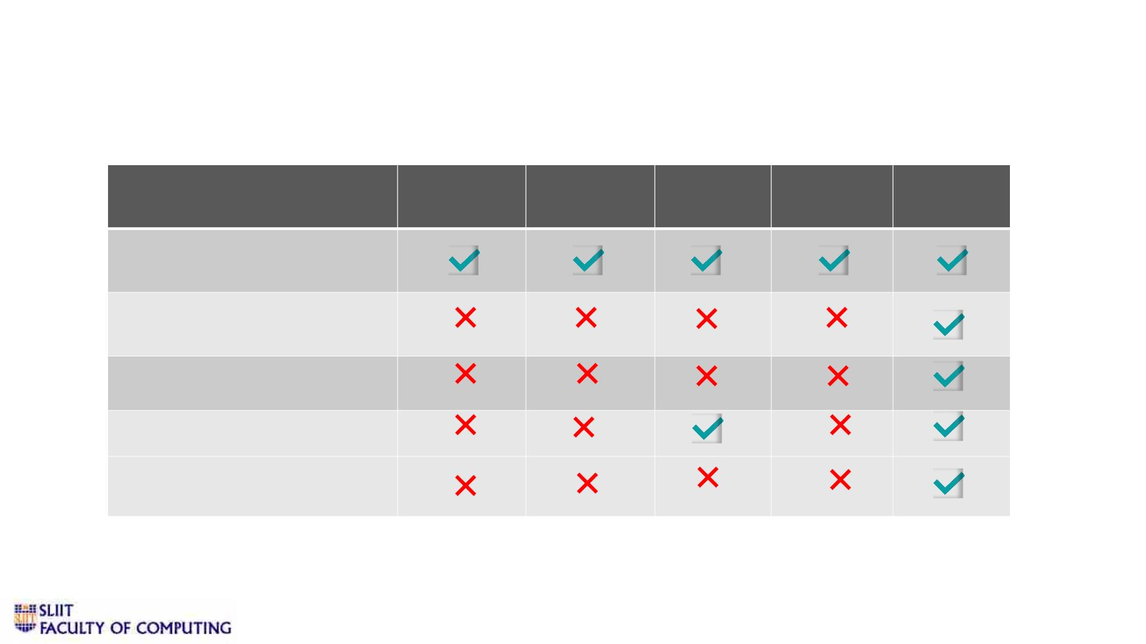
v Research Gap
Blind
Reader[6]
Intelligent VisualPal
Eye[7] [8]
Third
Eye[9]
Our
System
Features
Identifying Objects in the
environment
Providing an option to
record Voice memos.
Inbuilt radio
Color Detection
Optical Character
Recognition
IT19049878 | Jathusanan.E | 2022-227
11/9/2022
10

Slide 11

v Research Questions
How often do visually
impaired person fail to
identify the desired
object ?
How to provide a
good solution when
identifying things?
Do they use voice
recordings as an
effective way of
communication with
others?
Do they able to
utilize the radio in
their spare time?
IT19049878 | Jathusanan.E | 2022-227
11/9/2022
11

Slide 12

v Specific and Sub Objectives
• Specific Objective
Develop an object detection algorithm and a text detection
method to help visually impaired persons navigate their homes
more conveniently.
IT19049878 | Jathusanan.E | 2022-227
11/9/2022
12

Slide 13
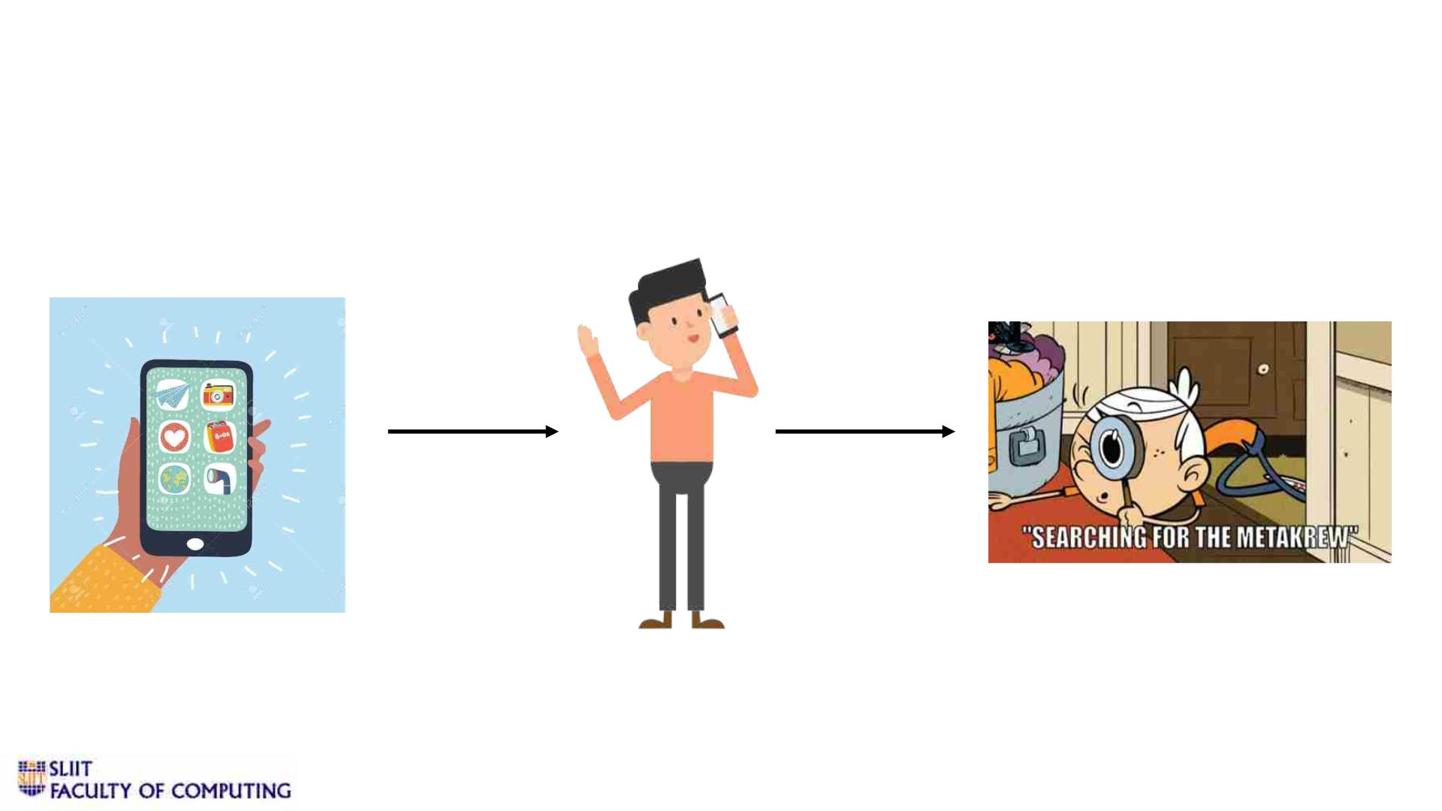
• Sub Objectives
1. Users provide the object name and our system will find the object in their surroundings.
IT19049878 | Jathusanan.E | 2022-227
11/9/2022
13

Slide 14
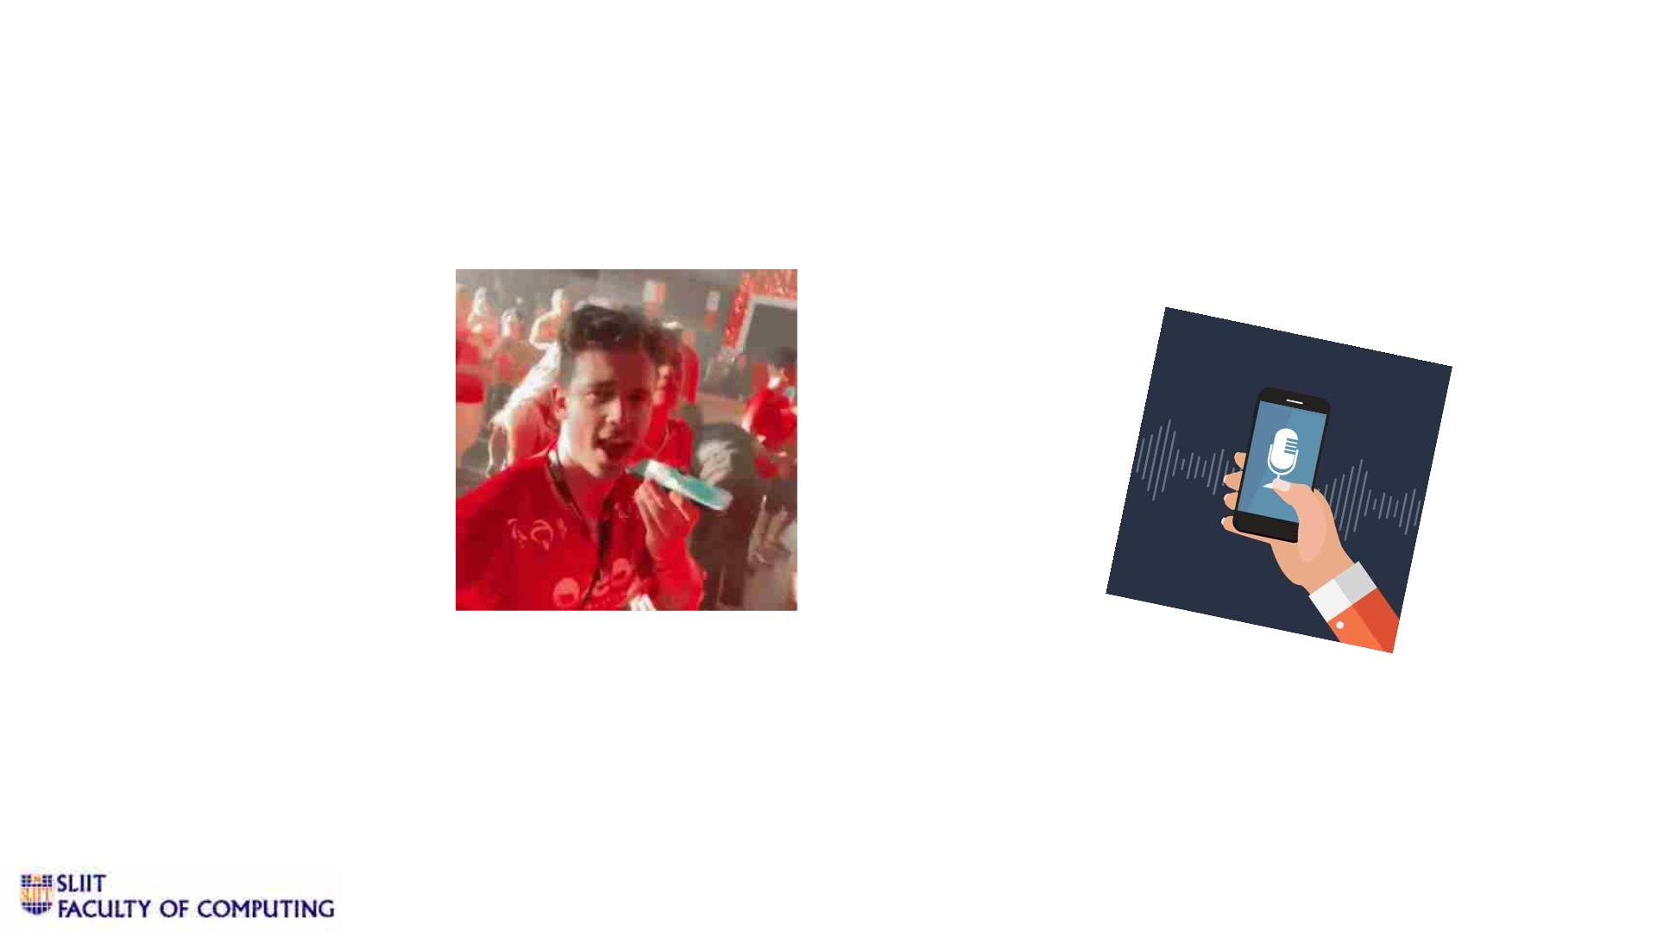
2. Users can record custom voice recordings to share with their loved ones.
IT19049878 | Jathusanan.E | 2022-227
11/9/2022
14

Slide 15
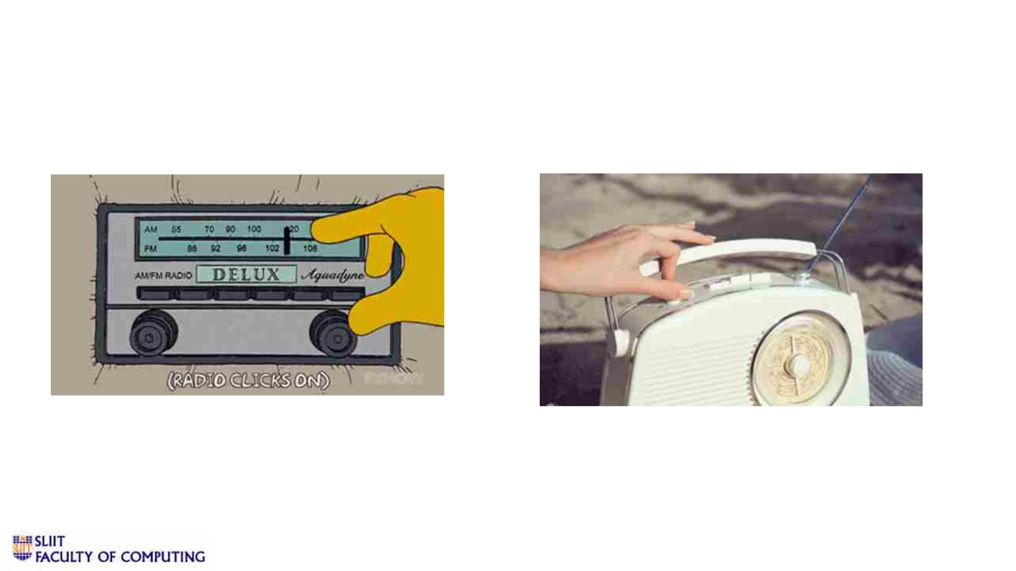
3. Users can play radio with their voice commands
IT19049878 | Jathusanan.E | 2022-227
11/9/2022
15

Slide 16
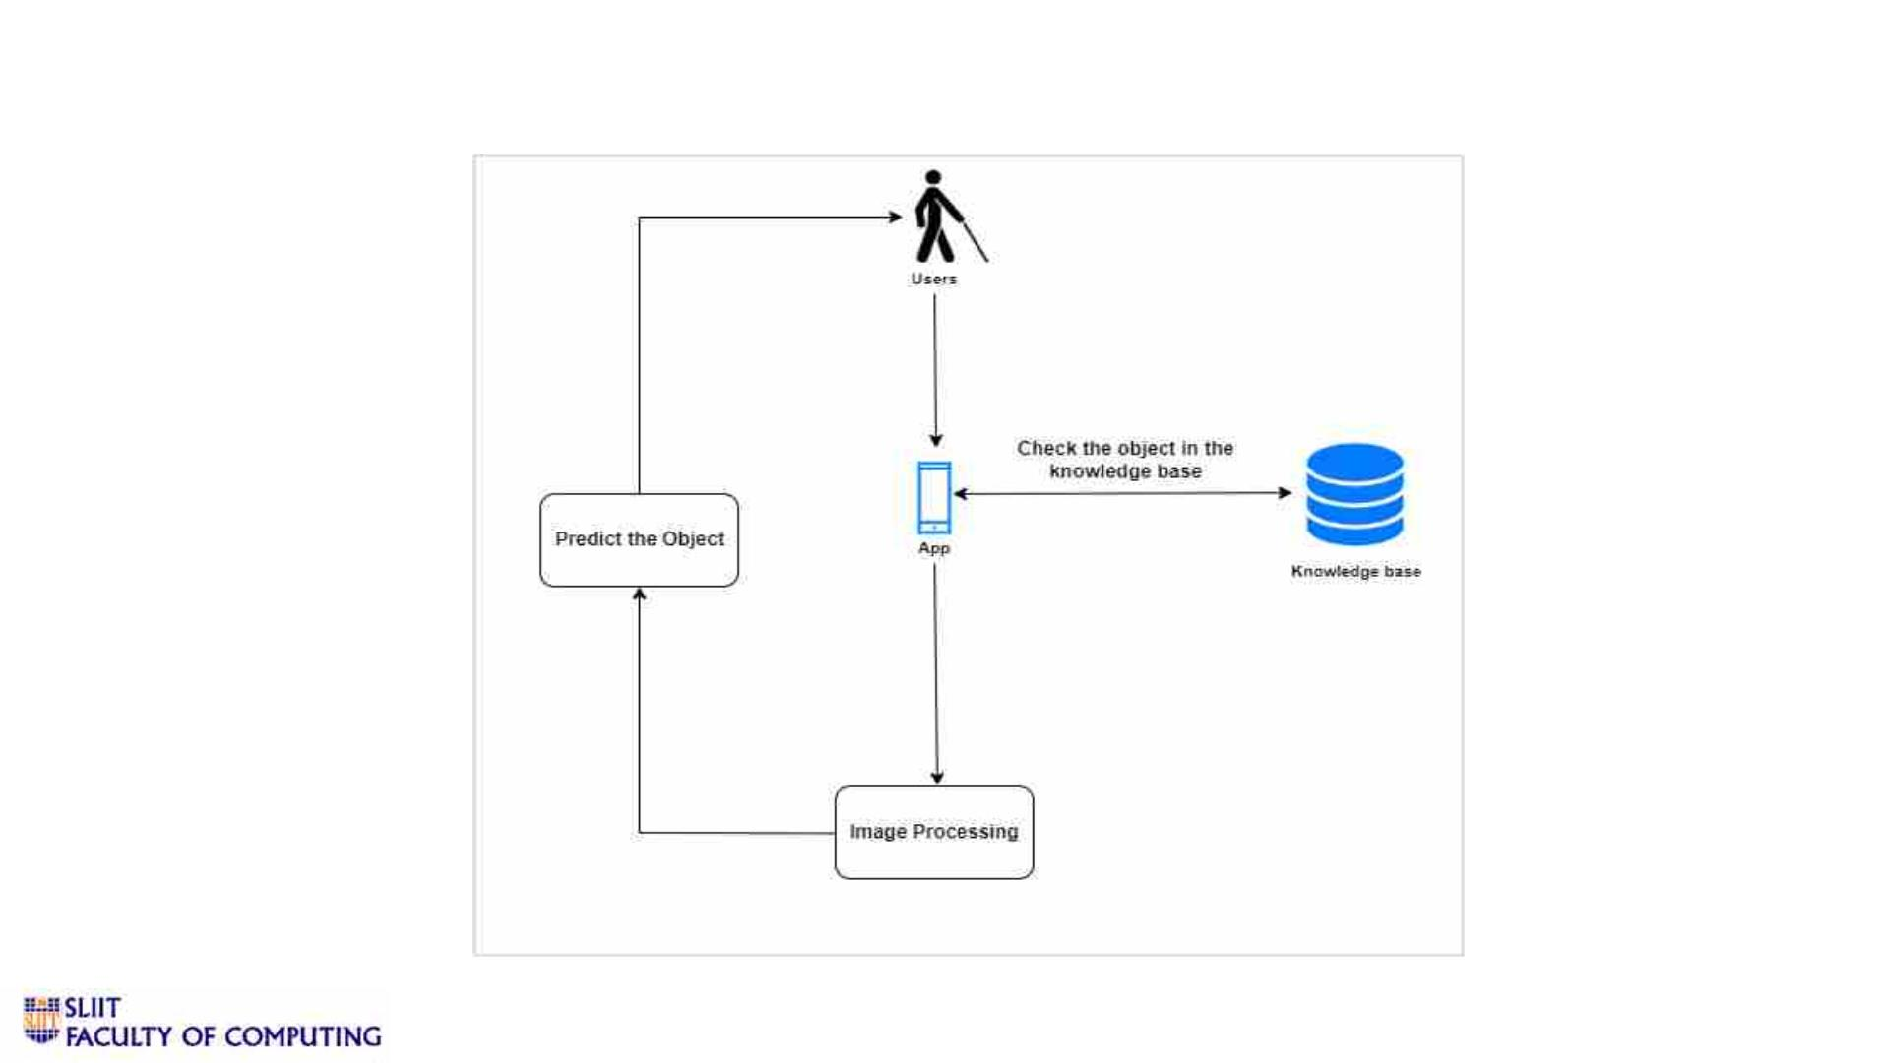
v Methodology
IT19049878 | Jathusanan.E | 2022-227
11/9/2022
16

Slide 17
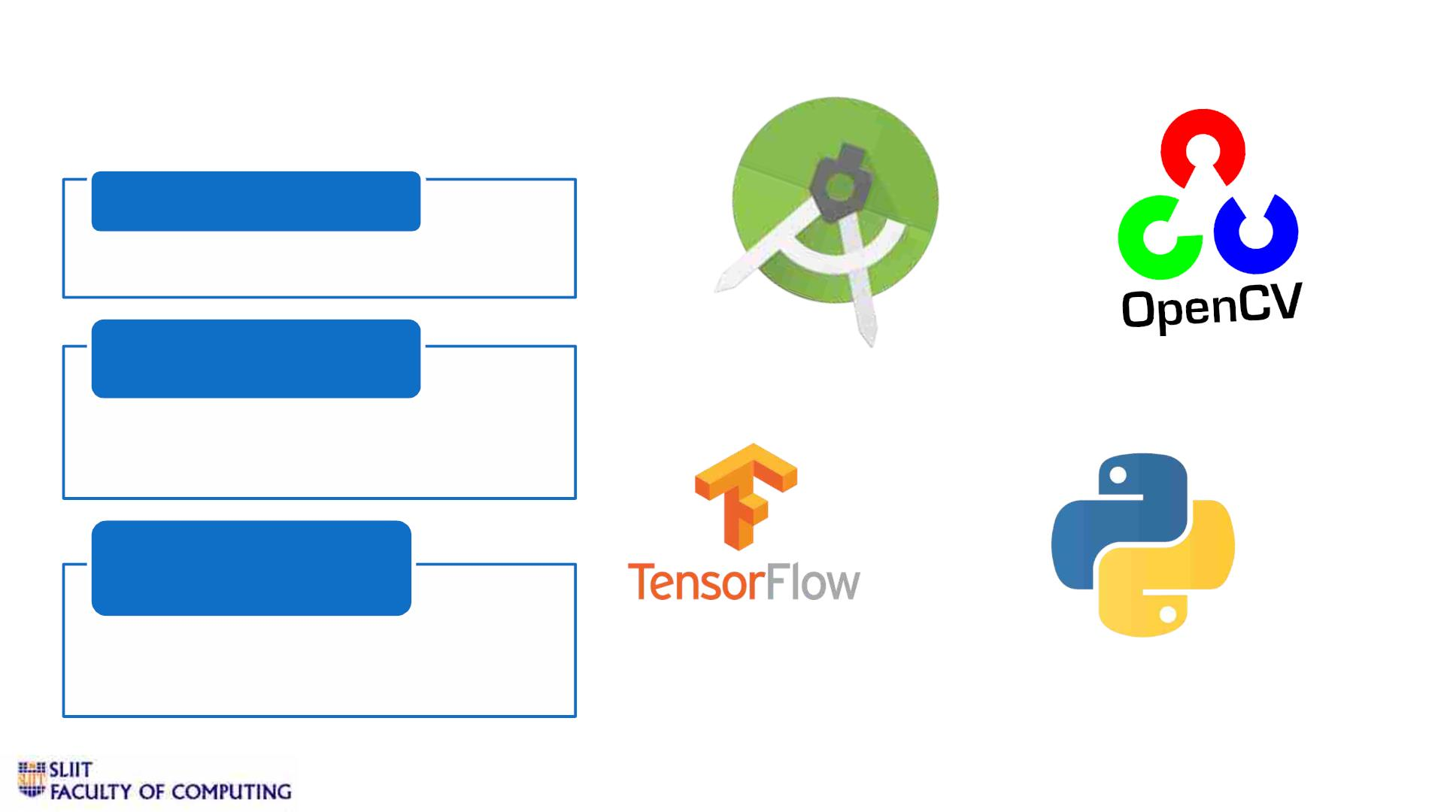
v Technologies
Mobile Application
• Android Studio
Backend & Database
• Python
• Firebase
Frameworks & Library
• OpenCV
• TensorFlow
IT19049878 | Jathusanan.E | 2022-227
11/9/2022
17

Slide 18
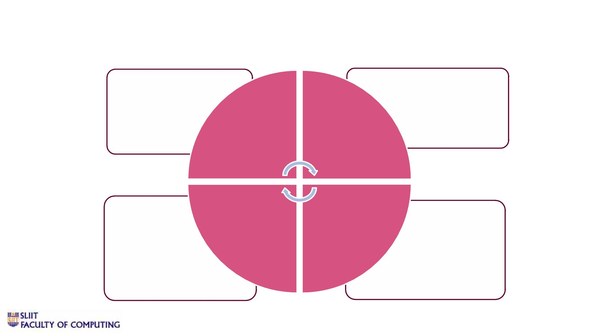
v Requirements
• User login
• Security
• Correct recognition
of voice commands
• Availability
• Usability
• Detect Required
objects
Non-
Functional
Requirement
s
• Performance
Functional
Requirement
s
System
Requirement
s
User
Requirement
s
• Storage
• Good quality camera
• Good microphone
• An android camera
smartphone
• Internet connectivity
IT19049878 | Jathusanan.E | 2022-227
11/9/2022
18

Slide 19
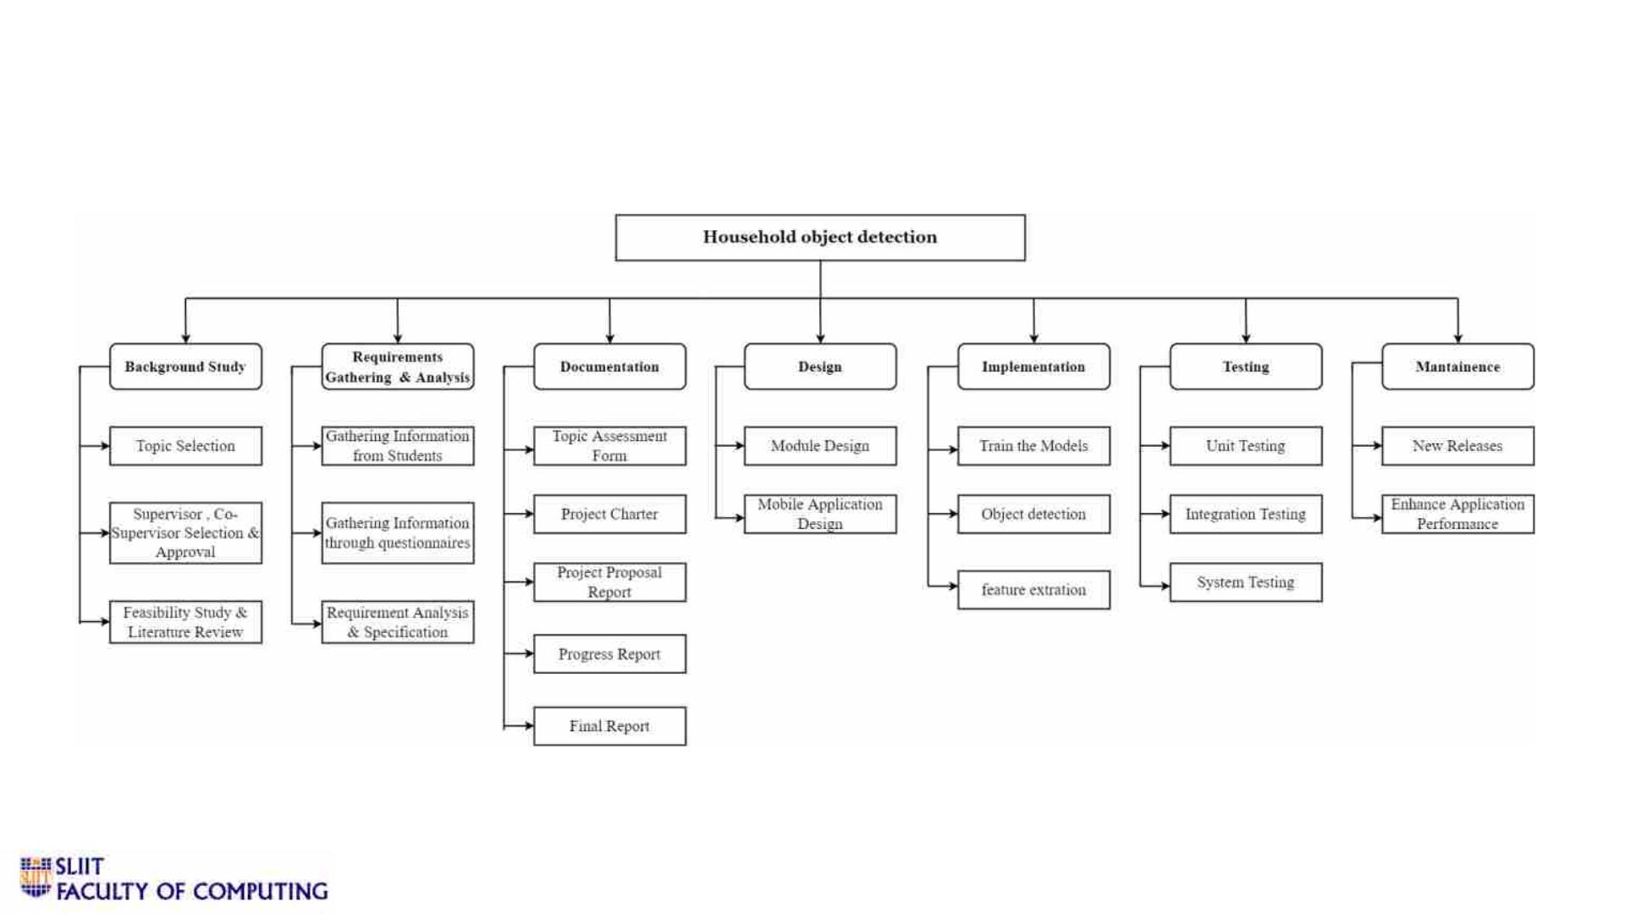
v Work Breakdown Structure
IT19049878 | Jathusanan.E | 2022-227
11/9/2022
19

Slide 20
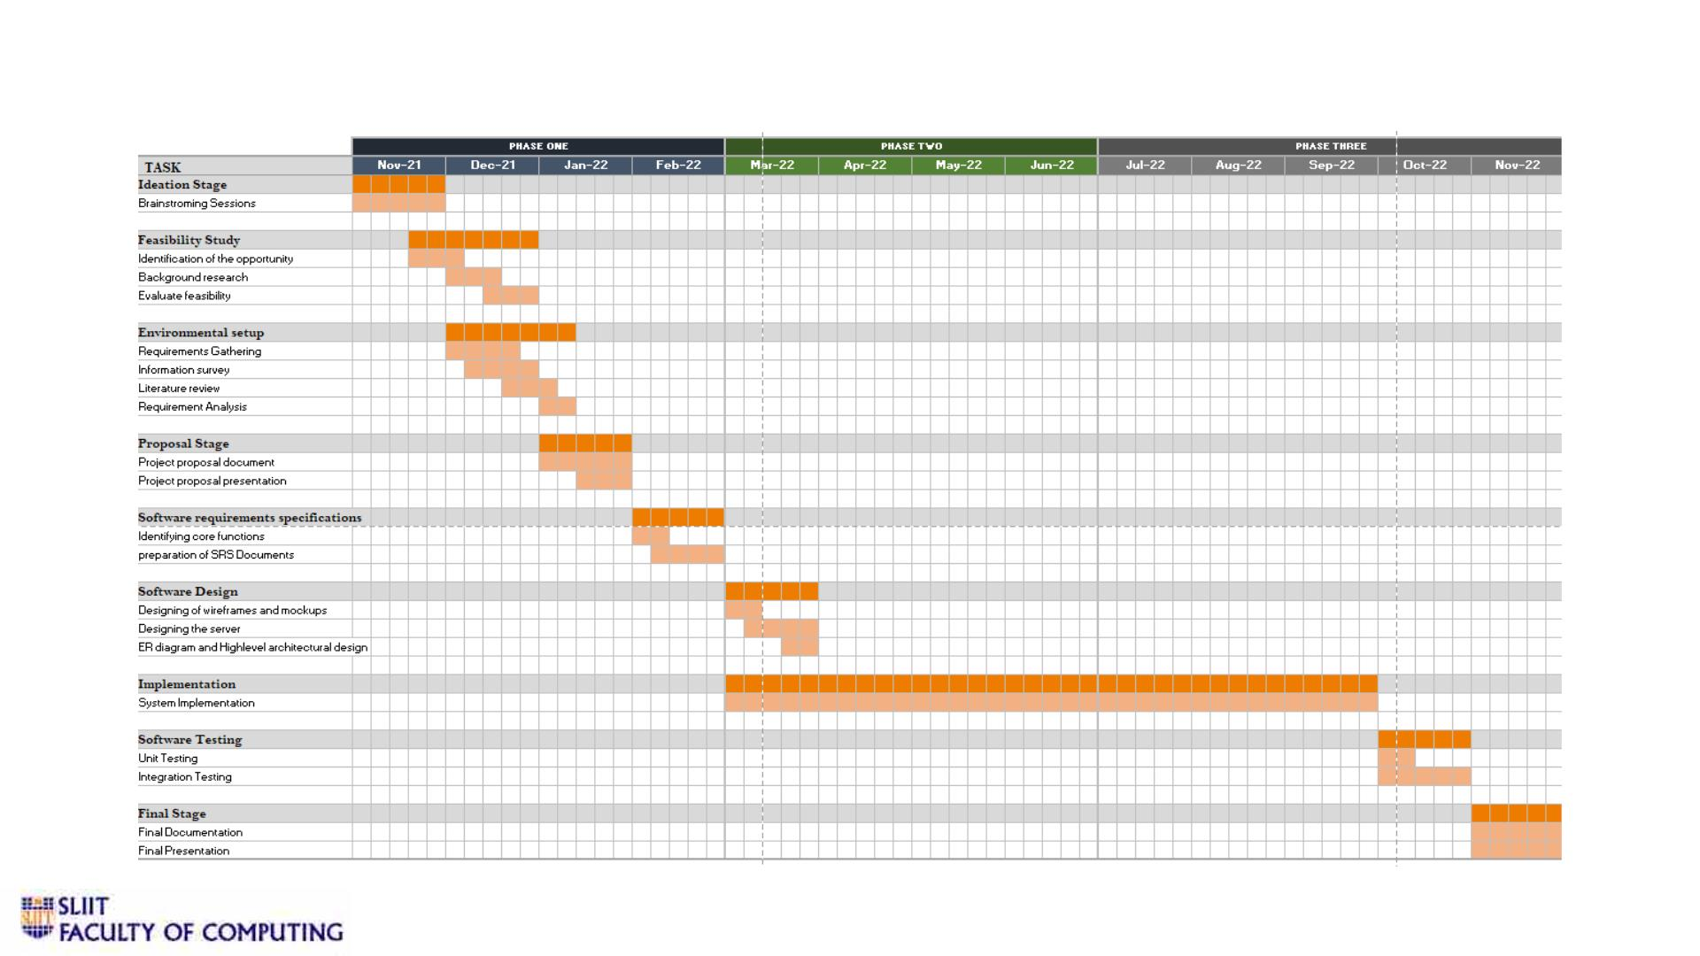
v Gantt Chart
IT19049878 | Jathusanan.E | 2022-227
11/9/2022
20

Slide 21

References
[1] Bradshaw, J. L. Nettleton, N. C. Spehr, K. (1982). Braille reading and left and right hemispace. Neuropsychologia 20, 493–500.
[2] R. Tapu, B. Mocanu and E. Tapu, "A survey on wearable devices used to assist the visual impaired user navigation in outdoor environments,"
2014 11th International Symposium on Electronics and Telecommunications (ISETC), Timisoara, 2014, pp. 1-4.
[3] R. Tapu, B. Mocanu and E. Tapu, "A survey on wearable devices used to assist the visual impaired user navigation in outdoor environments,"
2014 11th International Symposium on Electronics and Telecommunications (ISETC), Timisoara, 2014, pp. 1-4
[4] Ahmed, Syed Faiz, Hazry Desa, Fahad Azim, Ammar Surti, and Waqas Hussain. "Remote access of SCADA with online video streaming." In
2013 8th International Conference on Computer Science & Education, pp. 270-274. IEEE, 2013.
[5] Ahmed, Syed Faiz, George Banky, Aaron Blicblau, and M. Kamran Joyo. "Augmented reality with Haptic technology based online
experimental based distance learning education technique." In AIP Conference Proceedings, vol. 1775, no. 1, p. 030068. AIP Publishing, 2016.
[6] G. Sainarayanan, “Blind Reader for Visually Impaired”, Ph. D. Thesis, University Malaysia Sabah, 2002.
[7] M. Awad, J. E. Haddad, E. Khneisser, T. Mahmoud, E. Yaacoub and M. Malli, "Intelligent eye: A mobile application for assisting blind
people," 2018 IEEE Middle East and North Africa Communications Conference (MENACOMM), 2018.
[8] C. Kang, H. Jo and B.Kim, “VisualPal for Visually Impaired Person”, The Journal of KICS, vol. 36, no. 3, pp. 195-304, 2011.
[9] I. S. E. H. Alex Krizhevsky, “Third Eye” in Neural Information Processing Systems Conference, Toronto, 2012.
11/9/2022
21

Slide 22
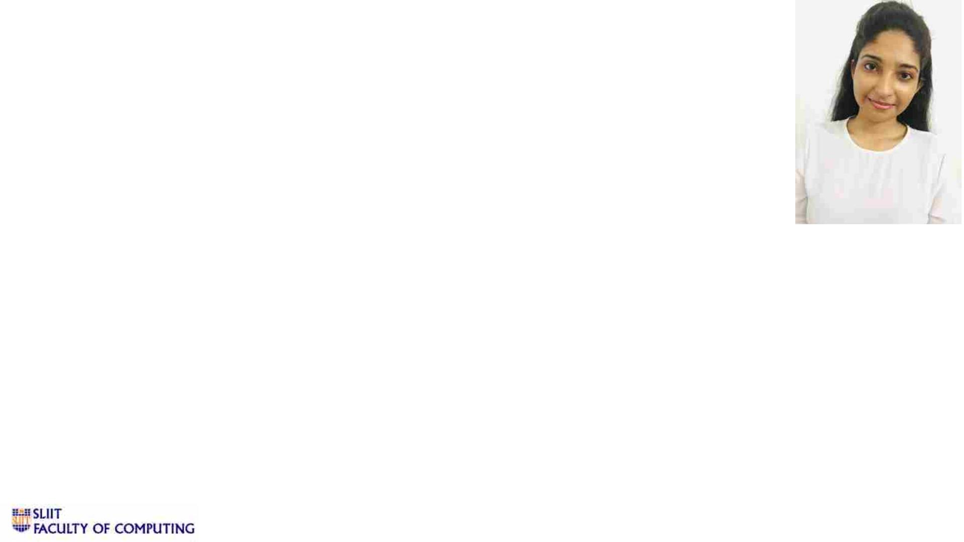
IT19008424 | WERAGODA W. R. J. M.
Software Engineering
ITXXXXXXXX | <<Student Name>> | <<Project ID>>
11/9/2022
22

Slide 23

Indoor and outdoor Sign Detection
2022-277
IT19008424 | Weragoda W.R.J.M.| 2022-227
11/9/2022
23

Slide 24
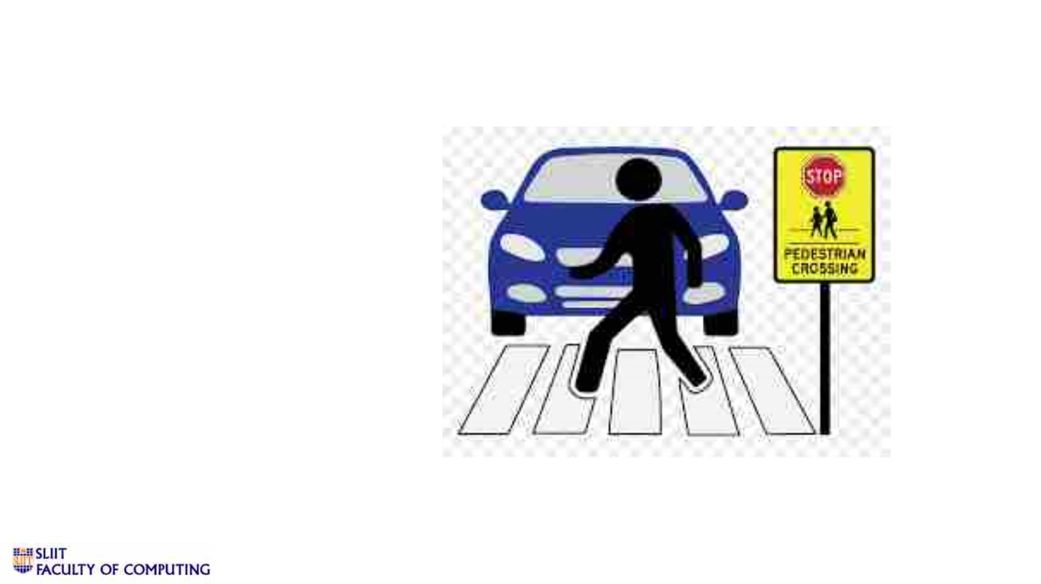
INTRODUCTION
Background / Research Gap
Research Question
Research Objectives
I TI TX 1X9X0X0X8X4X2X4 | <W<eSrt au gdoednat NWa.mR.eJ.>M>.| 2| 0 2<2<-P2r2o7j e c t ID>>
11/9/2022
24

Slide 25
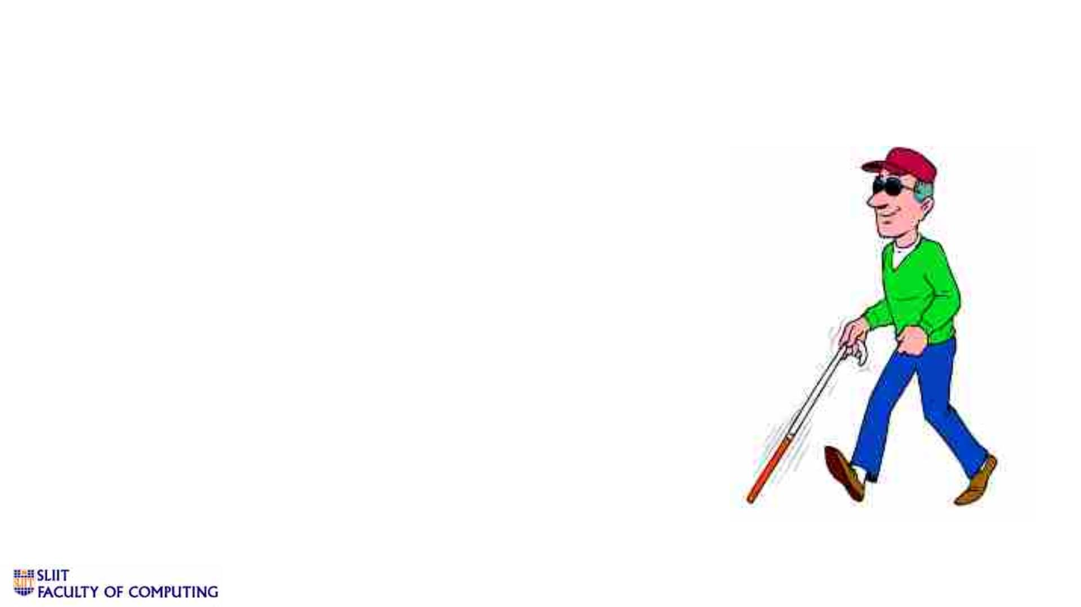
v Background
q Our world is populated with visual information that
a sighted person makes use of daily.
q Unfortunately, the visually impaired are deprived
from such information, which limits their mobility
in unconstrained environments.
q About 250 million people are visually impaired
worldwide, yet most indoor environments do not
cater for their accessibility needs.
IT19008424 | Weragoda W.R.J.M.| 2022-227
11/9/2022
25

Slide 26
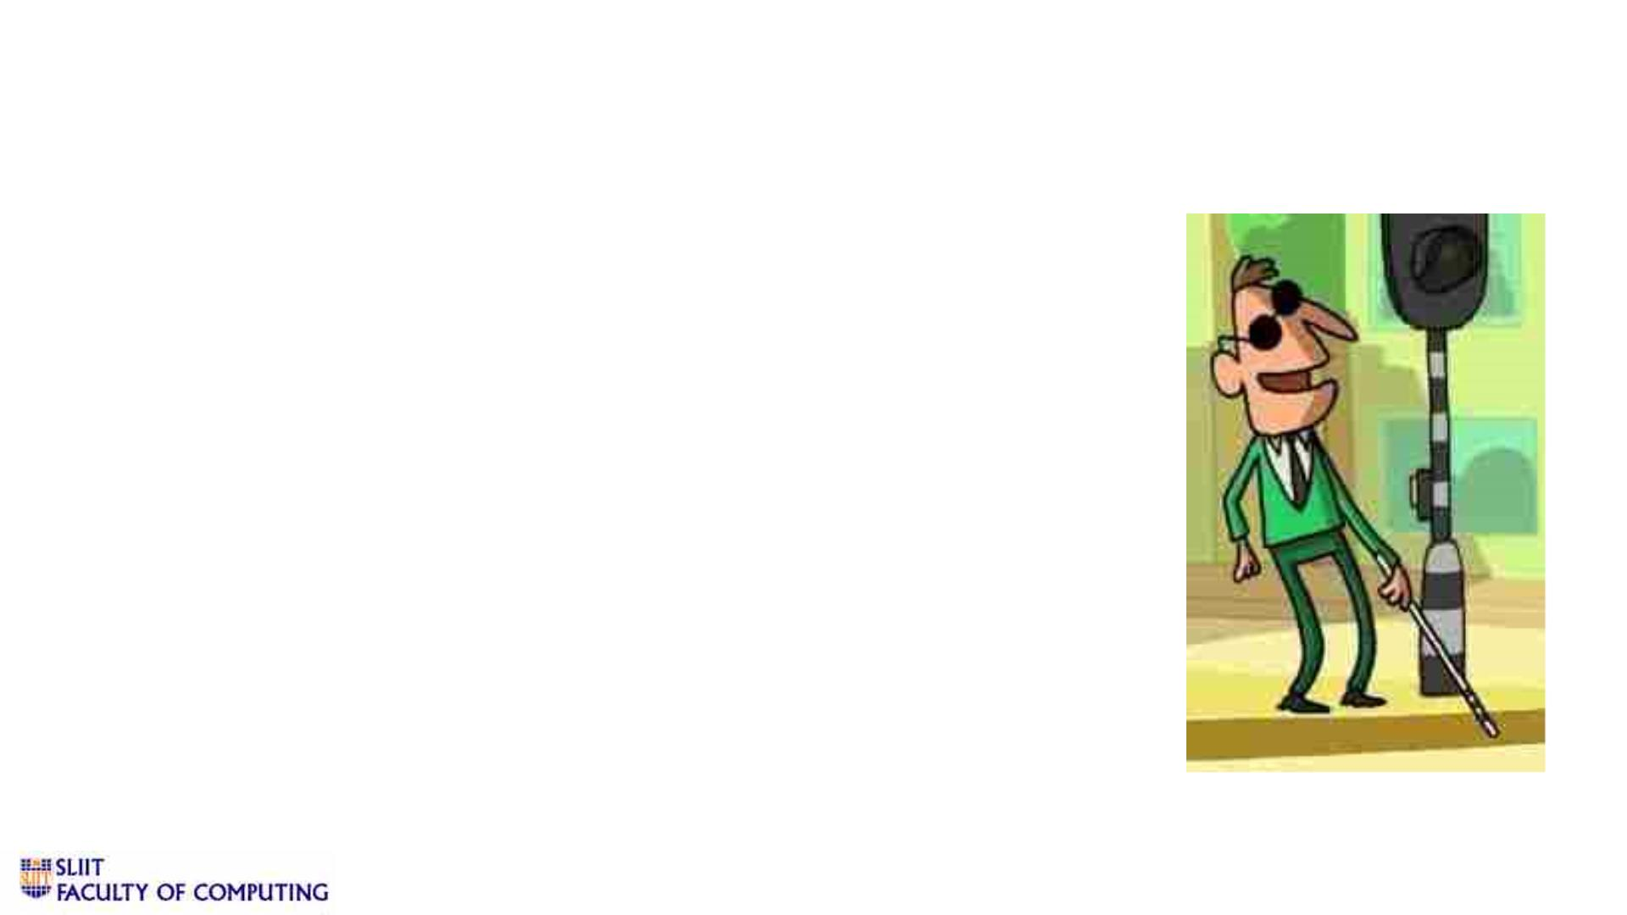
v Background
q The technological innovations during the past few decades
have neglected the fact that there is still a need to assist
blind people’s navigational requirements.
q Compared to other disabilities, people with visual disabilities
often require more assistance with daily activities.
q Although there are notable initiatives that help provide
environmental feedback(via sounds) to blind people, but they
have not been standardised yet or distributed well enough to
a sufficient range of interactive systems.
IT19008424 | Weragoda W.R.J.M.| 2022-227
11/9/2022
26

Slide 27

Research Problem
• Blind people face difficulties when navigating
unfamiliar environments.
• Many computer-vision problems remain
unsolved due to external environmental
challenges caused by cluttered background,
occluded objects, the change in illumination and
other constraints.
• The computational complexity of pattern
recognition and image understanding are some
of the challenges.
IT19008424 | Weragoda W. R. J. M.| 2022-227
11/9/2022
27

Slide 28
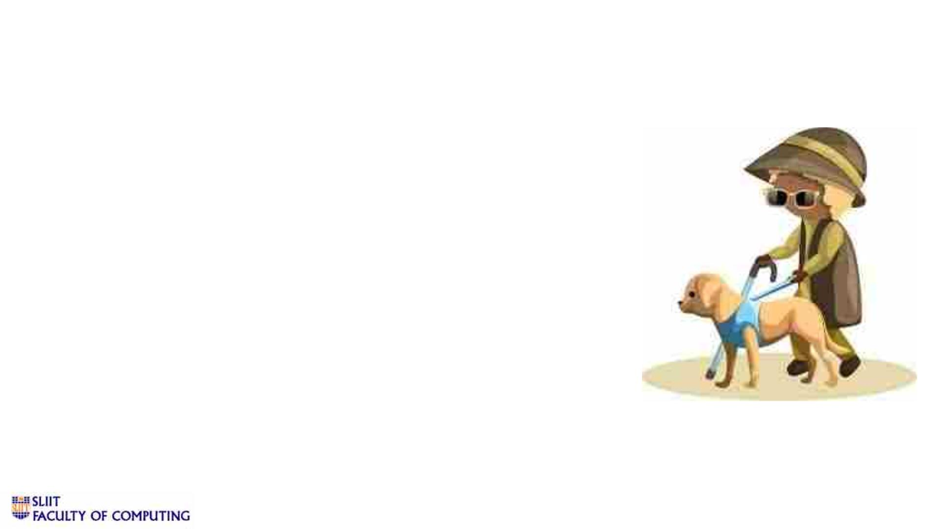
Research Problem
• The information displayed on indoor/outdoor
signs and notice boards is of no use to them.
In order to assist them with this challenge, we
propose a real time system that can recognise
a selection of indoor and outdoor navigational
signs placed over clear backgrounds.
• The selection of signs will consist of common
samples from several different types of indoor
and outdoor signs.
IT19008424 | Weragoda W. R. J. M.| 2022-227
11/9/2022
28

Slide 29

Proposed System
• user-friendly
• low-cost
• can be installed on a smartphone.
- The system is user-friendly, and a low-cost system which can be
installed on a smartphone. There are multiple types of equipment
for blind people. But they are too expensive. The inability to
afford this type of equipment has restricted the usage of them.
- Rather than using a costly system the “SNT" application can be
installed directly on any android mobile phone.
- They can operate android smartphones as a normal person.
IT19008424 | Weragoda W. R. J. M.| 2022-227
11/9/2022
29

Slide 30
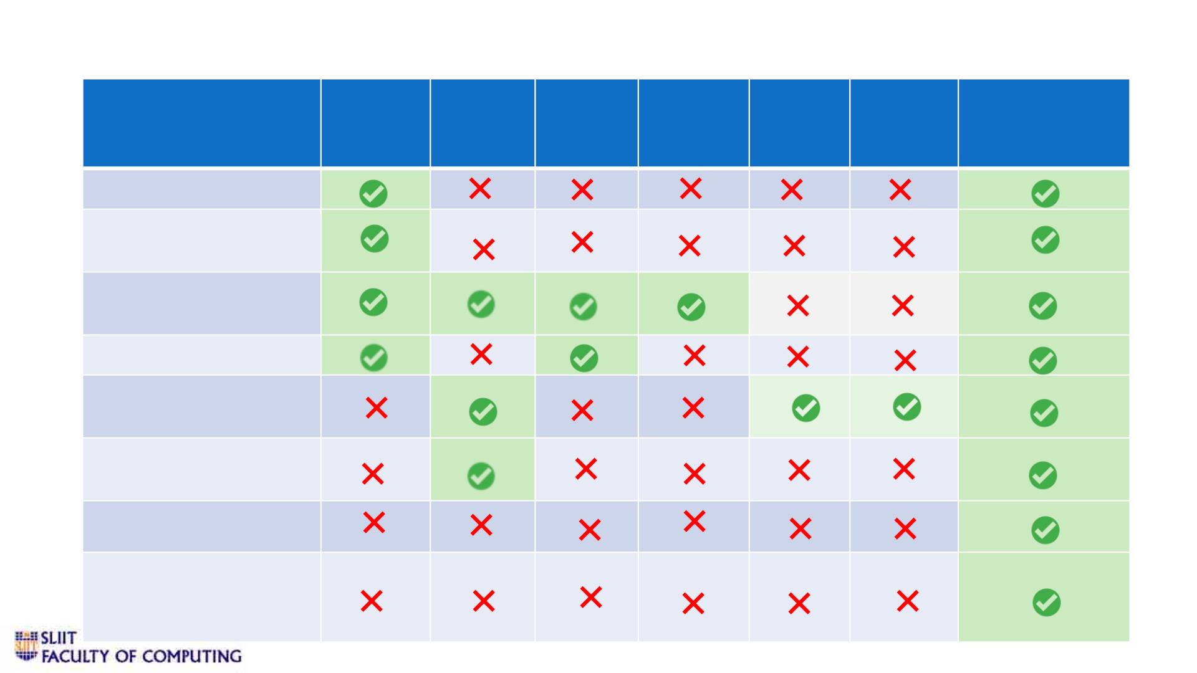
v Research Gap
Research Researc Researc Research Researc Research
Smart
Navigation
Tool
A [1]
h B [2]
h C [3]
D [4]
h E [5]
F [6]
Indoor Sign Detection
Outdoor Sign
Detection
Notify user via Voice
mode
Identify text in signs
Overcome lighting
conditions.
Overcome different
viewing angels
Occlusion and Cutter
Cover all the colours
and shapes that signs
can posses
IT19008424 | Weragoda W.R.J.M. | 2022-227
11/9/2022
30

Slide 31

v Specific and Sub Objectives
• Specific Objective
Develop an indoor and outdoor sign detection method just
by pointing mobile camera around visual impaired people,
in order to determine the signs and notify the user about
the object via audio or vocal mode.
IT19008424 | Weragoda W.R.J.M| 2022-227
11/9/2022
31

Slide 32
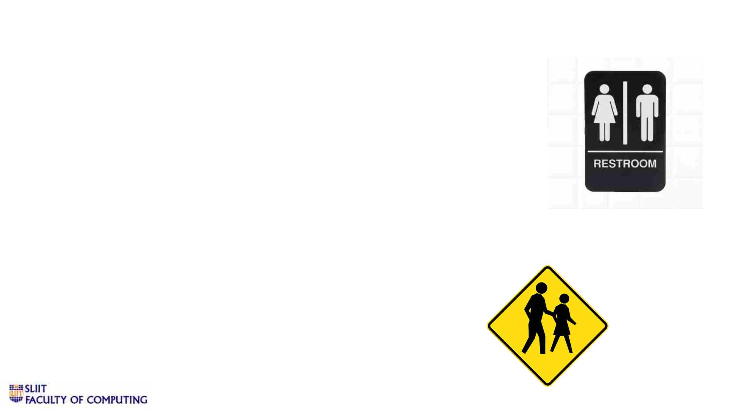
vSub Objectives
• Detect Indoor Signs in user path.
• Detect Outdoor Signs in user path.
• Design and train a models to identify Signs.
• Design and train a model to identify the color of the sign
• Train a model to give vocal instruction.
IT19008424 | W R J M Weragoda | 2022-227
11/9/2022
32

Slide 33
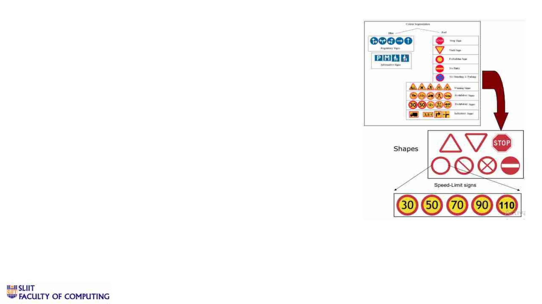
v Research Methodology
System Diagram
Technologies
Techniques
Requirements
Work Breakdown Structure / Gantt Chart
IT19008424 | Weragoda W. R. J. M.| 2022-227
11/9/2022
33

Slide 34
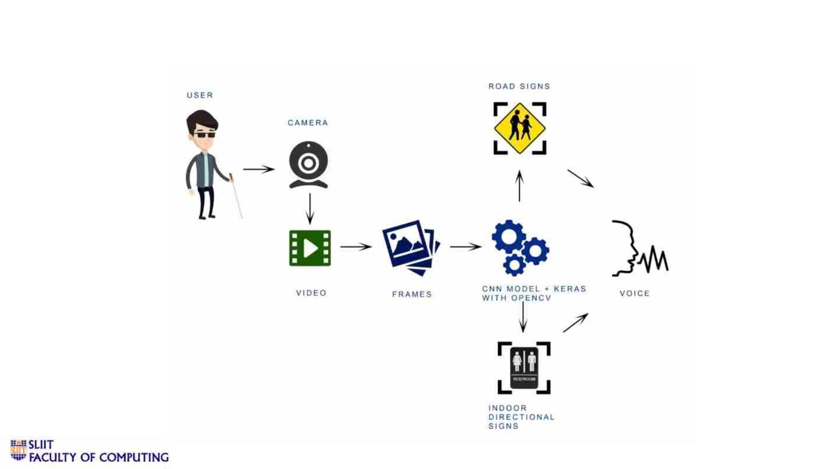
System Diagram
IT19008424 | Weragoda W.R.J.M.| 2022-227
11/9/2022
34

Slide 35

v Technologies
Frontend
ReactJS, Android Studio
Backend
Python, Java
Jupyter Notebook and Google colab
Anaconda and PIP
Libraries
Scikit-learn ,OpenCV, dlib
Matplotlib, Numpy, Pandas
Python REST API : Flask
Database
Firebase
Deployment
AWS
IT19008424 | Weragoda W.R.J.M.| 2022-227
11/9/2022
35

Slide 36

v Techniques
• OpenCV – access our cam/video stream in an efficient manner.
• CNN module + Keras- Feature Extraction and Sign Classification
• Dataset – German Traffic Sign Recognition Benchmark
(GTSRB).
IT19008424 | W R J M Weragoda| 2022-227
11/9/2022
36

Slide 37
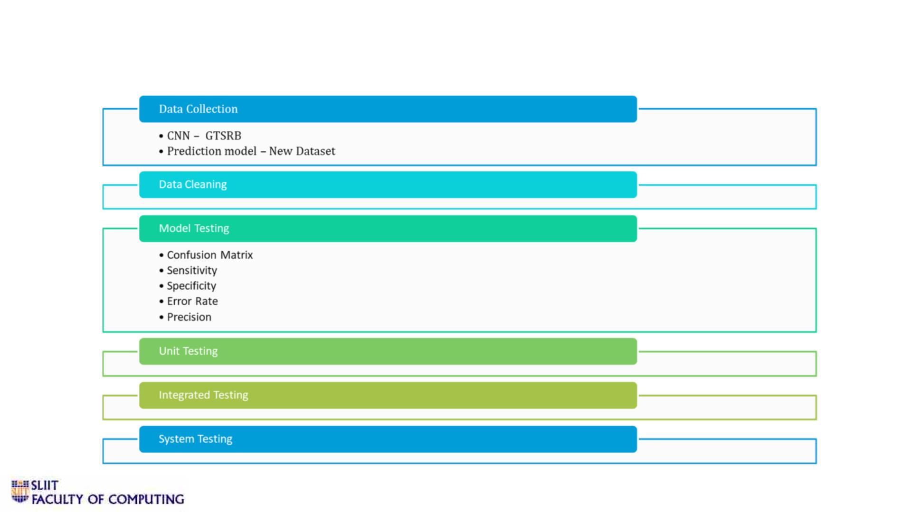
v Self Evaluation Plan
IT19008424 | W R J M Weragoda| 2022-227
11/9/2022
37

Slide 38
Requirements
User Requirements
• User should be able to notify indoor signs.
• User should be able to notify outdoor signs.
• User should be able to identify the direction of the sign.
• User should be able to get voice assistance.
• User should be able to operate the system
independently.
IT19008424 | Weragoda W. R.J. M. | 2022-227
11/9/2022
38

Slide 39
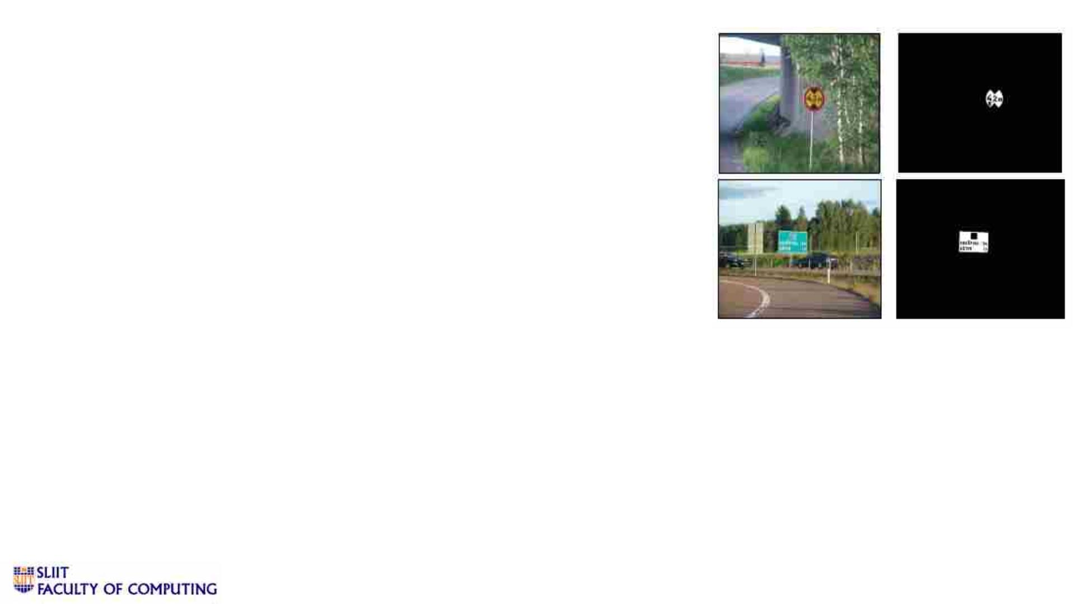
Functional Requirements
• Detect the indoor signs through the camera.
• Detect the road signs through the camera.
• Classify the sign by colour.
• Classify the sign by shape.
• If the sign has been recognized, notify the user about the
specific sign via voice notification.
IT19008424 | Weragoda W.R.J.M. | 2022-227
11/9/2022
39

Slide 40
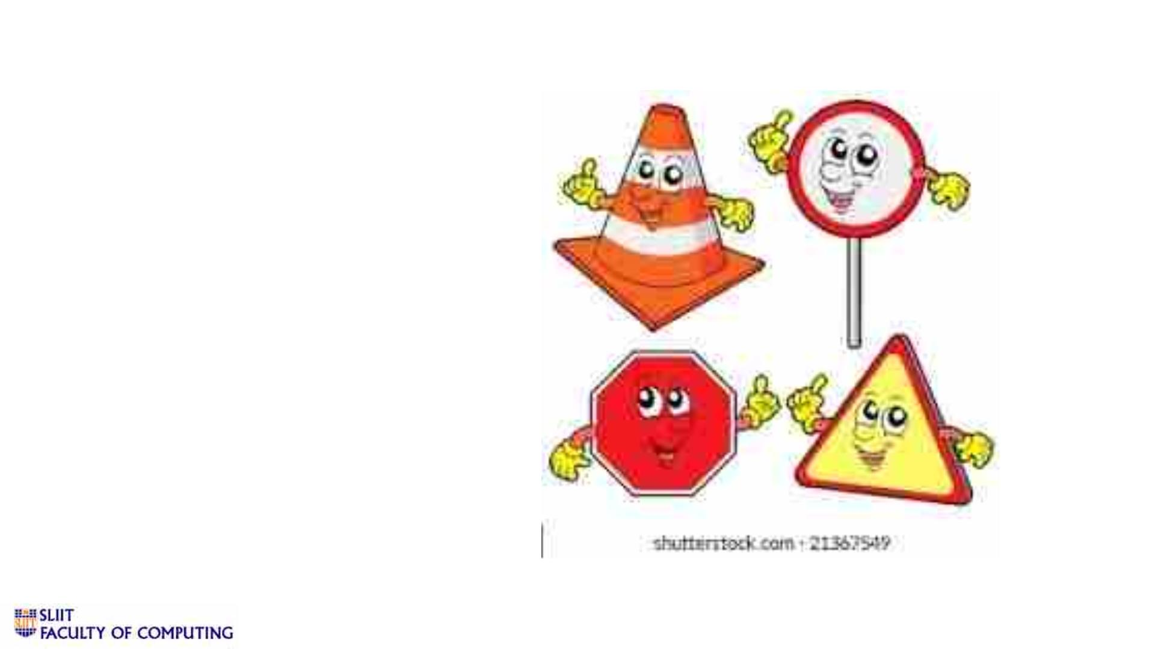
Non-Functional Requirements
• Accuracy
• Performance
• Usability
• Security
• Reliability
IT19008424 | Weragoda W.R.J.M. | 2022-227
11/9/2022
40

Slide 41
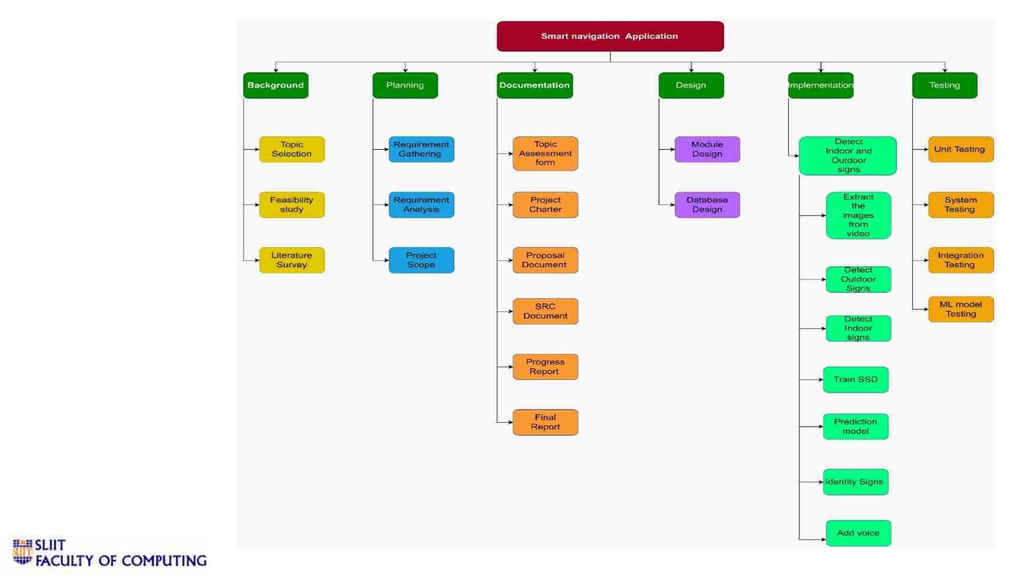
Work
Breakdown
Structure
IT19008424 | Weragoda W.R.J.M.| 2022-227
11/9/2022
41

Slide 42
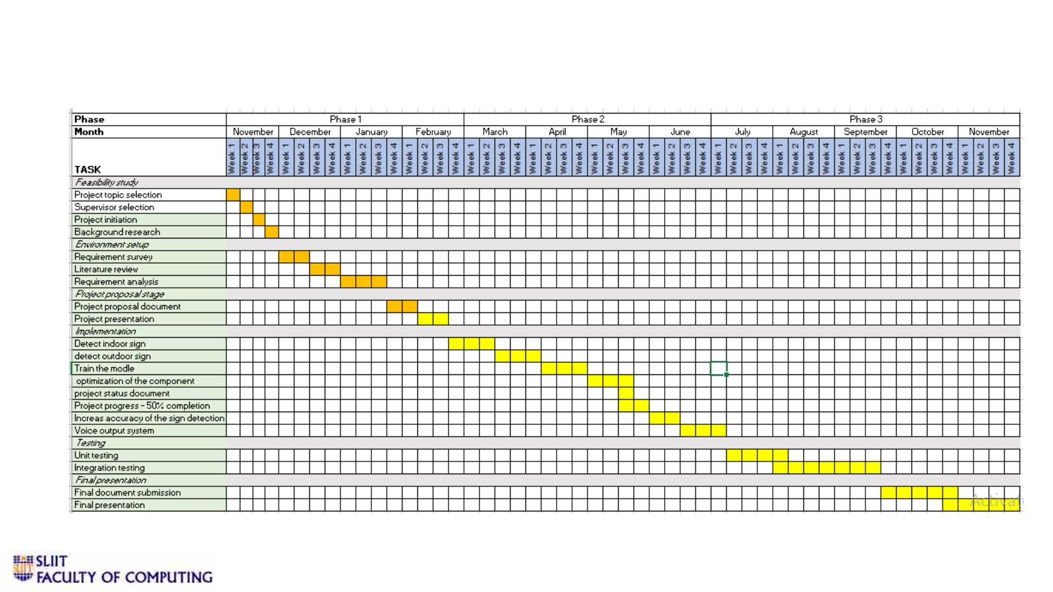
Gantt Chart
IT19008424 | Weragoda W.R.J.M.| 2022-227
11/9/2022
42

Slide 43
References
•
•
•
•
•
[1] Object recognition for blind people based on features extraction.
[2] Object Detection and Identification for Blind People in Video Scene
[3] Blind Navigation System Using Image Processing and Embedded System
[4] World Health Organization, Webpage:http://www.who.int//mipfiles/2400/AllenFoster.pdf
[5] F. Wong, R. Nagarajan, S. Yaacob and A. Chekima, “Electronic travel aids for visually impaired – A guided tour”, Proceedings of Conference
in Engineering in Sarawak, 2000, pp. 377-382.
•
•
•
[6] L. Kay, “An Ultrasonic sensing probe as a mobility aid for the blind”, Ultrasonics 1964, 2: 53-59.
[7] N. Pressey, “Mowat Sensor”, Focus 3, 1977, pp. 35-39
[8] P. Meijer, “An Experimental System for Auditory Image Representations,” IEEE Transactions on Biomedical Engineering, vol. 39, no 2, pp.
112-121, Feb 1991.
•
•
•
[9] G. Sainarayanan, “On Intelligent Image Processing Methodologies Applied to Navigation Assistance for Visually Impaired”, Ph. D. Thesis,
University Malaysia Sabah, 2002.
[10] . Balakrishnan, G. Sainarayanan, R. Nagarajan and S. Yaacob, “Wearable Real-Time Stereo Vision for the Visually Impaired,” Engineering
Letters, vol. 14, no. 2, 2007.
[11] G. P. Fajarnes, L. Dunai, V. S. Praderas and I. Dunai, “CASBLiP- a new cognitive object detection and orientation system for impaired
people,” Proceedings of the 4th International Conference on Cognitive Systems, ETH Zurich, Switzerland, 2010.
IT19008424 | Weragoda W.R.J.M.| 2022-227
11/9/2022
43

Slide 44
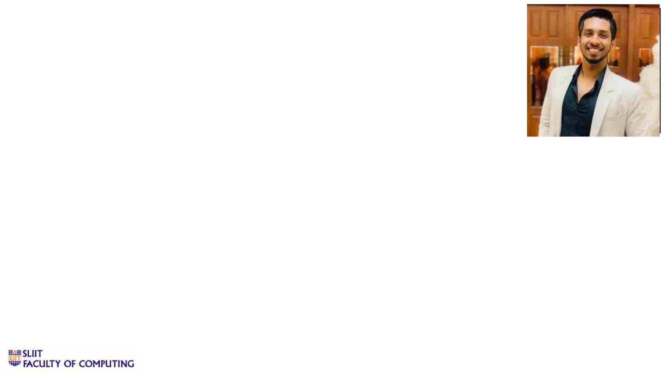
IT19042152 | W A MADUSHAN
Software Engineering
IT19042152 |W A MADUSHAN | 2022-227
11/9/2022
44

Slide 45
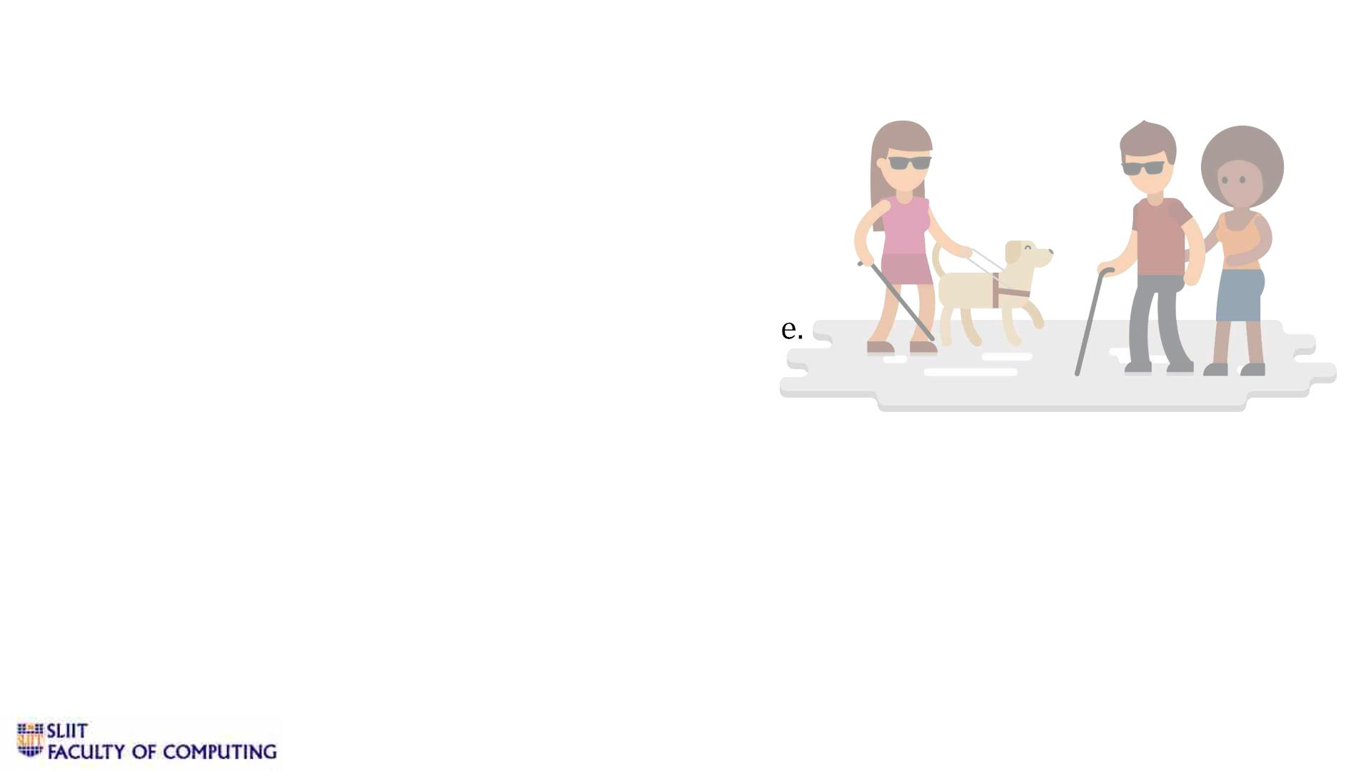
Introduction
v Background
• Mobility is significant issue for blinds.
• White cane – identify obstacles in their rout
• Surface and obstacle detection is important for visually impaired peoples
• Electronic Travel aids for blinds with the advancement of modern technology.
IT19042152 | W A MADUSHAN | 2022-227
11/9/2022
45

Slide 46
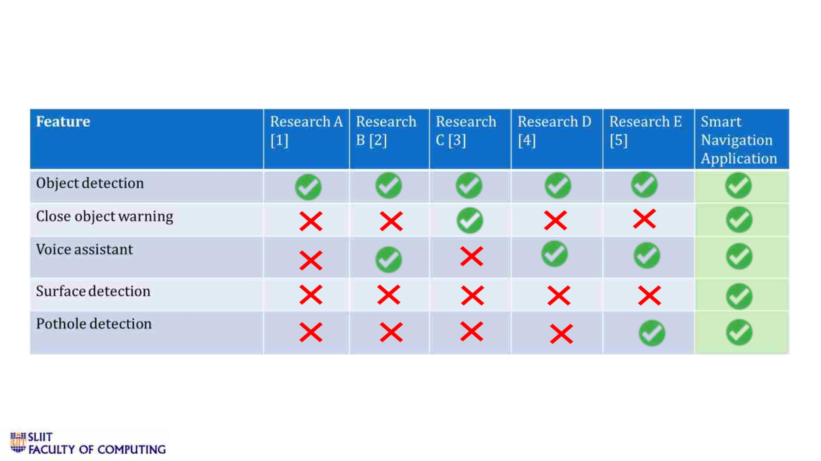
v Research Gap
IT19042152 | W A MADUSHAN | 2022-227
11/9/2022
46

Slide 47

Research Problem
• Visually impaired people are facing many difficulties while
comparing to others.
• Detecting obstacles and different surfaces is very difficult task using
traditional white cane.
• Existing Electronic Travel aids are more expensive.
IT19042142 | W A Madushan | 2022-227
11/9/2022
47

Slide 48

v Main and Sub Objectives
• Main Objective
Recognize obstacles and walking surface by using the camera and notify the user
about the object via audio or vocal mode.
IT19042152 | W A Madushan | 2022-227
11/9/2022
48

Slide 49
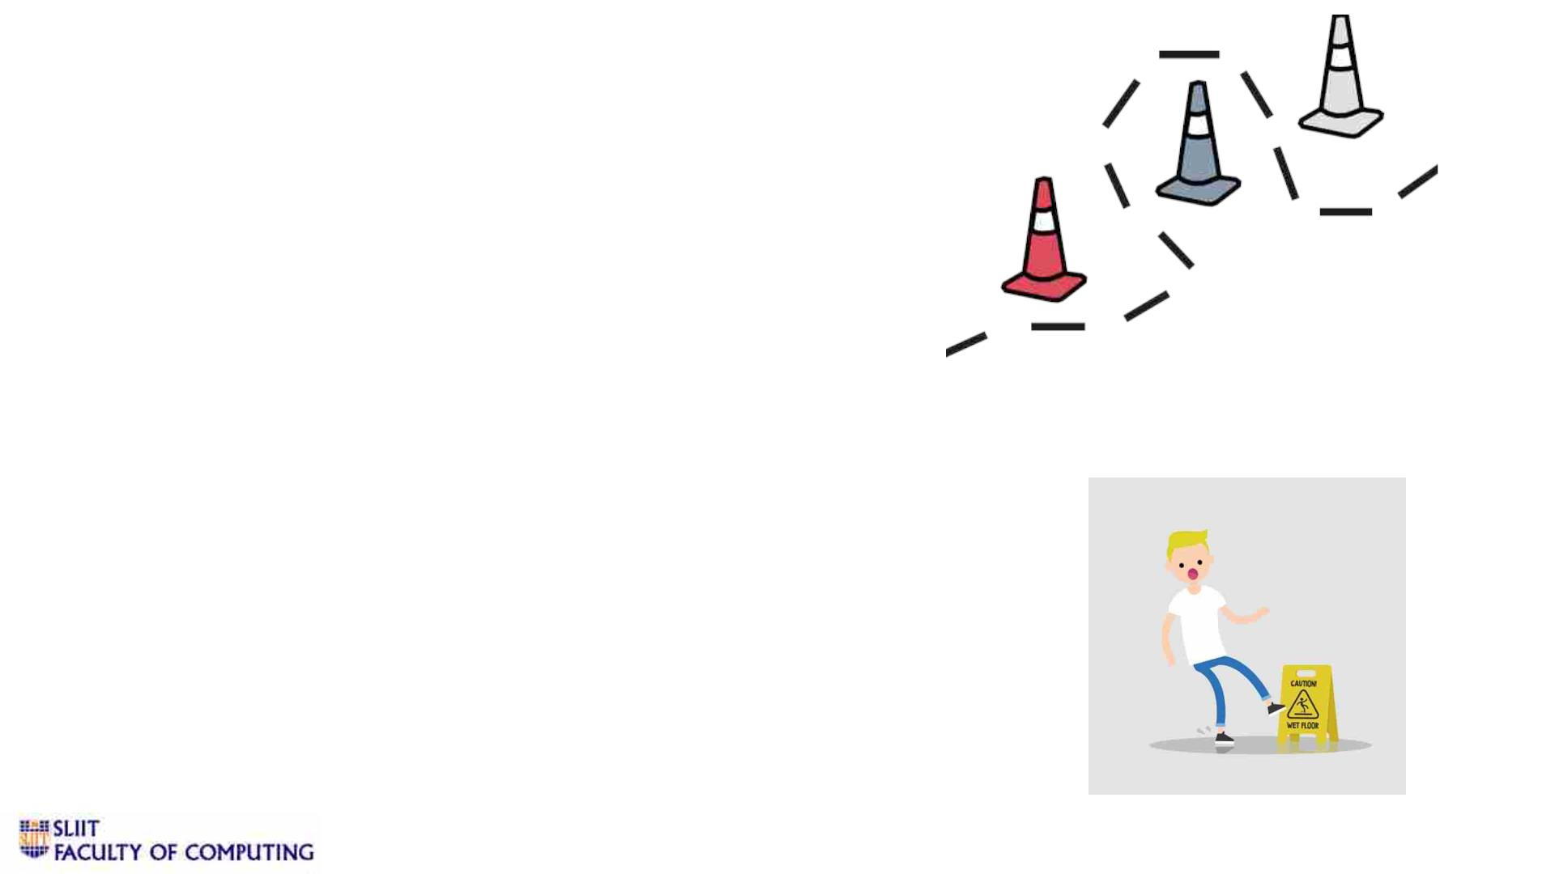
v Sub Objectives
• Detect obstacles in user path.
• Detect walking surface.
• Design and train a models to identify obstacle name and surface behavior
according to inputs.
• Train a models to identify close obstacles.
• Train a model to give vocal instruction.
IT19042152 | W A Madushan | 2022-227
11/9/2022
49

Slide 50

Research Methodology
System Diagram
Technologies
Techniques
Requirements
Work Breakdown Structure / Gantt Chart
IT19042152 | W A Madushan | 2022-227
11/9/2022
50

Slide 51
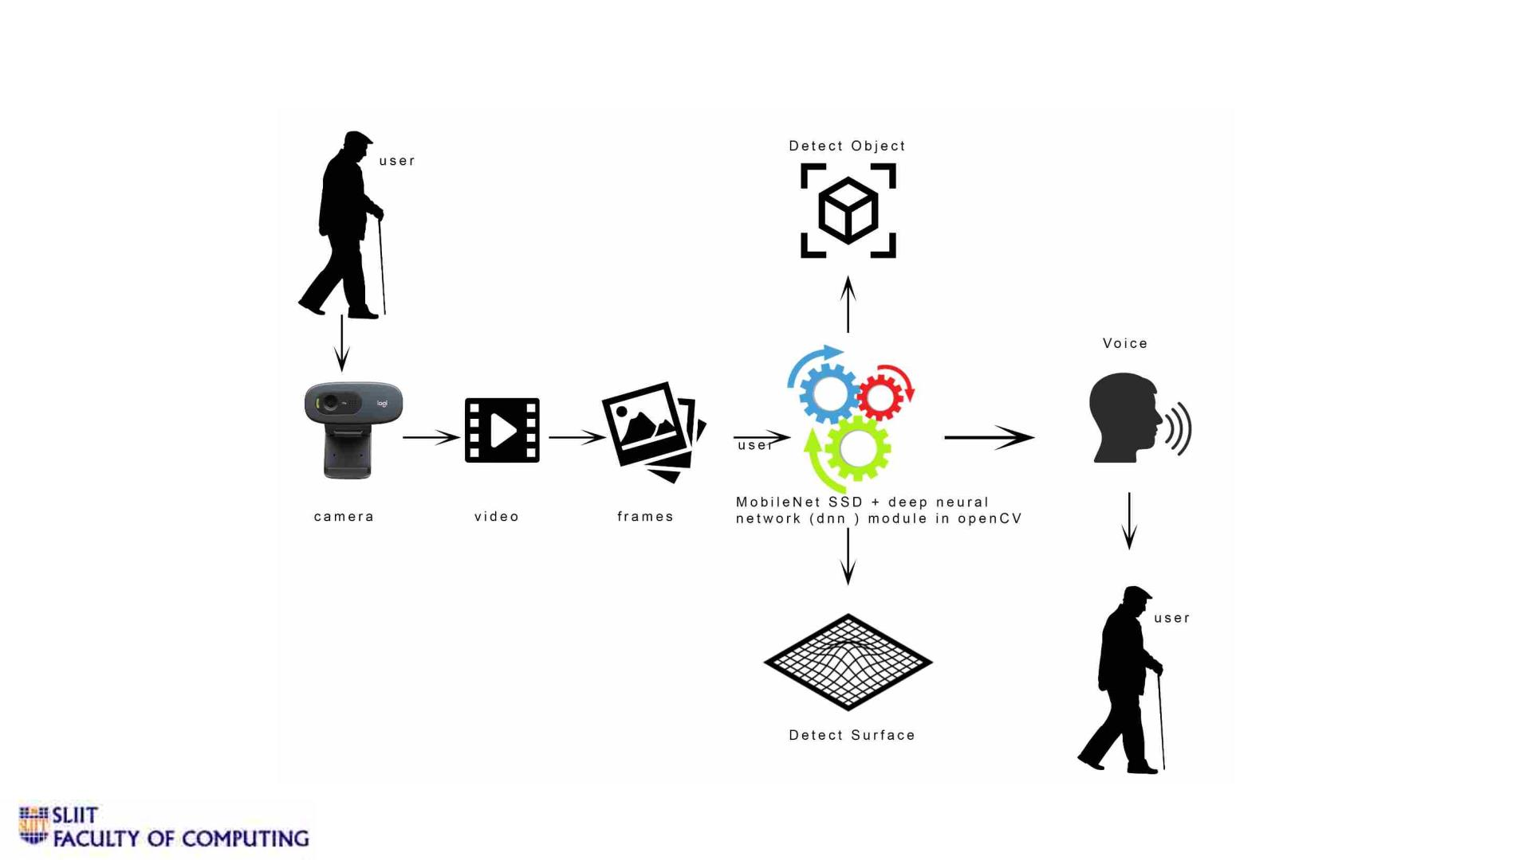
v System Diagram
IT19042152 | W A Madushan | 2022-227
11/9/2022
51

Slide 52
v Technologies
Frontend
ReactJS, Android Studio
Backend
Python, Java
Jupyter Notebook and Google colab
Anaconda and PIP
Libraries
Scikit-learn ,OpenCV, dlib
Matplotlib, Numpy, Pandas
Python REST API : Flask
Database
Firebase
Deployment
AWS
IT19049878 | Jathusanan.E | 2022-227
11/9/2022
52

Slide 53
v Techniques
• OpenCV – access our cam/video stream in an efficient manner.
• MobileNetSSD – object and surface detection model
• Dataset – COCO dataset.
IT19042152 | W A Madushan| 2022-227
11/9/2022
53

Slide 54
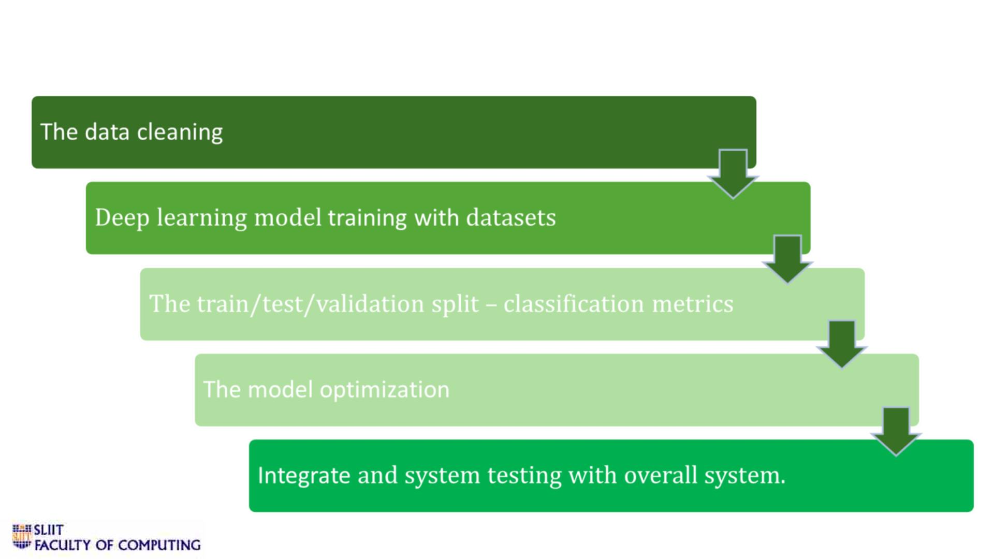
v Self-evaluation
IT19042152 | W A Madushan| 2022-227
11/9/2022
54

Slide 55
User Requirements
• User should be able to identify obstacles on their way.
• User should be notify about the behaviour of the walking surface.
• User should be warned, if the objects are too close.
• User should be able to operate the system independently.
• User should be able to get voice assistance.
IT19042152 | Madushan W. A. | 2022-227
11/9/2022
55

Slide 56
Functional Requirements
• Detect the obstacle through the camera.
• Detect the walking surface through the camera.
• Make a warning message for close objects.
• Generate a voice notification about obstacles and surface.
IT19042152 | Madushan W. A. | 2022-227
11/9/2022
56

Slide 57
Non-Functional Requirements
• Accuracy
• Performance
• Usability
• Security
• Reliability
IT19042152 | Madushan W. A. | 2022-227
11/9/2022
57

Slide 58
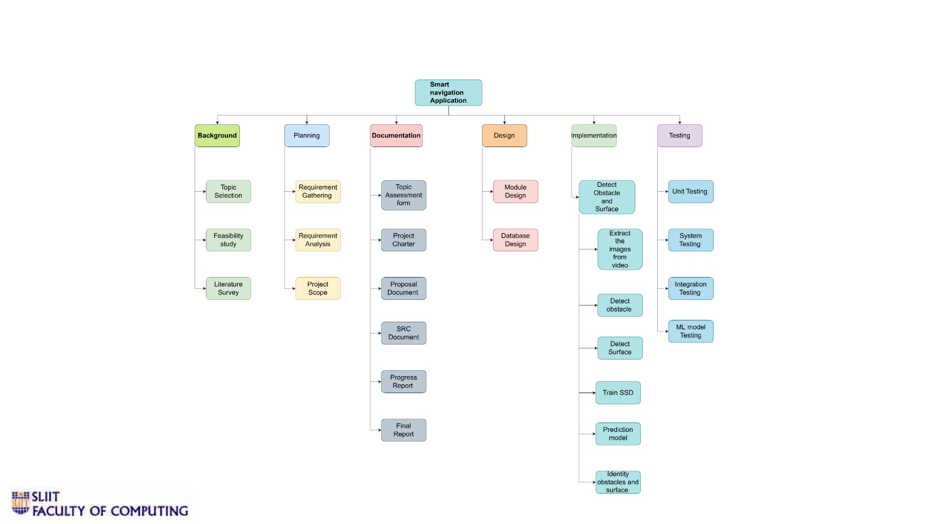
v Work Breakdown Structure
IT19042152 | W A MAdushan | 2022-227
11/9/2022
58

Slide 59
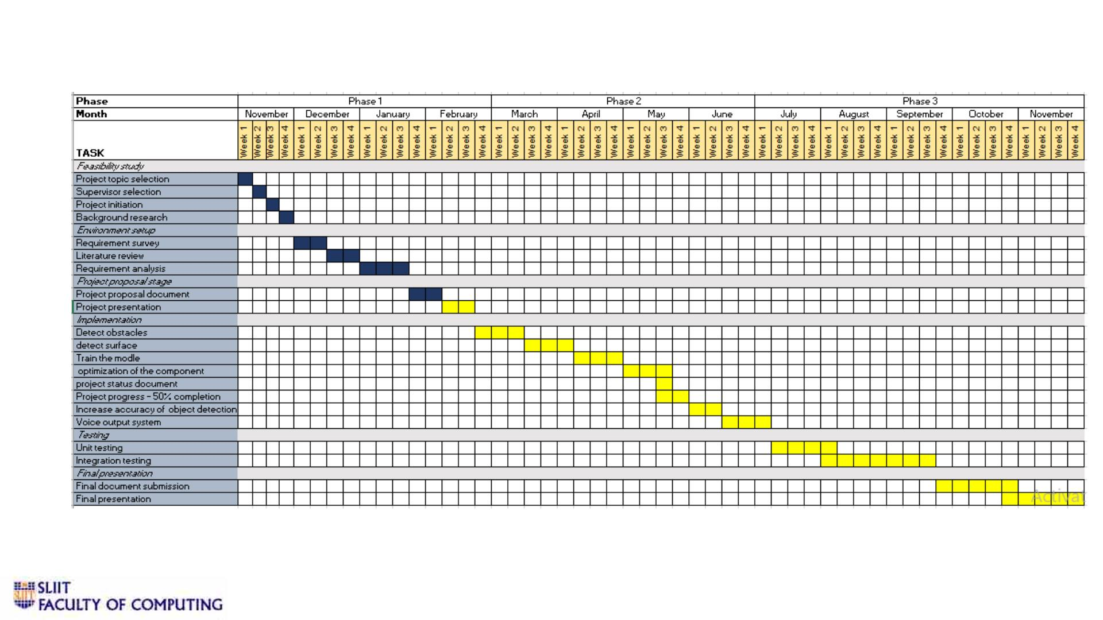
v Gantt Chart
IT19042152 | W A Madushan | 2022-227
11/9/2022
59

Slide 60
References
•
•
•
[1] H. Jabnoun, F. Benzarti and H. Amiri, "Object detection and identification for blind people in video scene," 2015 15th International
Conference on Intelligent Systems Design and Applications (ISDA), 2015, pp. 363-367, doi: 10.1109/ISDA.2015.7489256.
[2] Object Detection for Blind User’s Pooja Maid1, Omkar Thorat2, Sarita Deshpande3 Student, Dept. of Information Technology
Engineering, P.E.S’s Modern College of Engineering Pune,Maharashtra, India
[3] R. Kedia et al., "MAVI: Mobility Assistant for Visually Impaired with Optional Use of Local and Cloud Resources," 2019 32nd
International Conference on VLSI Design and 2019 18th International Conference on Embedded Systems (VLSID), 2019, pp. 227-232, doi:
10.1109/VLSID.2019.00058.
•
•
[4] Blind Assist: Project Proposal Oluwaseyitan Joshua Durodola Nathaniel Sims Chris Uruquhart
[5] Yashas, M., Maalik, K.S., M.Z.M., A., & K.P.S.H., D.S. (2017). Blind Guider: An IT Solution for Visually Impaired People. International
journal of scientific and research publications, 7.
•
•
•
•
[8] P. Meijer, “An Experimental System for Auditory Image Representations,” IEEE Transactions on Biomedical Engineering, vol. 39, no 2,
pp. 112-121, Feb 1991.
[9] G. Sainarayanan, “On Intelligent Image Processing Methodologies Applied to Navigation Assistance for Visually Impaired”, Ph. D.
Thesis, University Malaysia Sabah, 2002.
[10] . Balakrishnan, G. Sainarayanan, R. Nagarajan and S. Yaacob, “Wearable Real-Time Stereo Vision for the Visually Impaired,”
Engineering Letters, vol. 14, no. 2, 2007.
[11] G. P. Fajarnes, L. Dunai, V. S. Praderas and I. Dunai, “CASBLiP- a new cognitive object detection and orientation system for impaired
people,” Proceedings of the 4th International Conference on Cognitive Systems, ETH Zurich, Switzerland, 2010.
IT19042152 | W A Madushan | 2022-227
11/9/2022
60

Slide 61
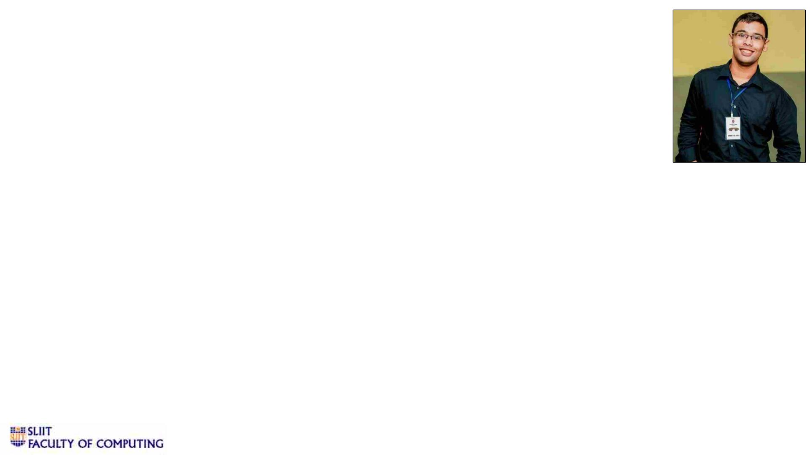
IT19109190 | KESHARA S.R.D.S.
Software Engineering
IT19109190 | Keshara S.R.D.S. | 2022-227
11/9/2022
61

Slide 62
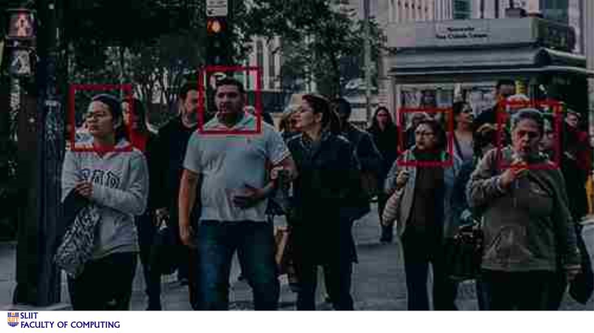
Face identification of known individuals
IT19109190 | Keshara S.R.D.S. | 2022-227
11/9/2022
62

Slide 63
v Background
• Vision is one of the most essential senses that an individual possess, where they would
learn to adapt to their surroundings and learn basic life skills.
• Visual impairment is a disability that is prevalent around many individuals in the current
society and though there are several helping tools that have been invented to assist this
community, most of them require large amounts of capital and contains very few
necessary features.
Ø The survey shows the prevalence of blindness in Sri Lanka as 1.7% among the age 40+ population.
Similarly, the survey revealed that 1.6 % and 15.4% had severe visual impairment and visual
impairment among the study population. [1]
• Visually impaired people encounter many challenges to complete their daily activities and
often require assistance from other people to overcome their shortcomings. Some of the
challenges that they face on a daily basis are as follows,
Ø Difficulty in navigation due to lack of identification of various obstacles in their path.
Ø Inability to identify loved ones from a distance.
Ø Difficulty to get immediate assistance in a stressful situation due to their visual impairment deficiency.
IT19109190 | Keshara S.R.D.S. | 2022-227
11/9/2022
63

Slide 64
v Background cont.
• Even though there are many difficulties faced by visually impaired people in their daily
lives, most of them overcome such difficulties by building up their senses such as touch,
hearing and taste. For the most part, these difficulties are overcome using various types
of technological tools developed to assist their daily activities.
Ø 3-D Sound Maps – creates a 3-D map by drawing on location data, sound beacons and sound output to
build a constantly evolving map of the surrounding environment.
Ø Braille – system of dots that is used by the visually impaired and blind people to read and write. Due to
innovations made on this concept, display included the BraiBook, a Braille e-reader that fits into the palm
of a hand, and even an electronic toy called the Braille Buzz, designed to teach Braille to preschoolers.
Ø Smart Glasses – set of glasses that can be used to read AI, provide navigation information and
potentially identify faces.
Ø Electric vehicles – vehicles that can be programmed to drive using AI at safe speeds while maximizing
traveler safety.
• The focus of this research project is to setup a system to support visually impaired
people to accurately identify their loved ones.
IT19109190 | Keshara S.R.D.S. | 2022-227
11/9/2022
64

Slide 65
vCurrent Technologies and Solutions
• A Static Hand Gesture and Face Recognition System for Blind People [2]
Ø Hand gesture recognition system and face recognition system has been implemented using which various
tasks can be performed. Dynamic images are being taken from a dynamic video and is being processed
according to certain algorithms.
• Smartphone based face recognition tool for the blind [3]
Ø The tool utilizes Smartphone technology in conjunction with a wireless network to provide audio feedback
of the people in front of the blind user.
• Ultrasonic smart glasses for blind [4]
Ø This device includes a pair of glasses and an obstacle detection module fitted in it in the center, a
processing unit, an output device i.e. a beeping component, and a power supply.
IT19109190 | Keshara S.R.D.S. | 2022-227
11/9/2022
65

Slide 66
vCurrent Technologies and Solutions cont.
• Intelligent eye: A mobile application for assisting blind people [5]
Ø The application provides assistance to visually impaired people by providing a set of useful features: light
detection, color detection, object recognition, and banknote recognition.
• Third Eye: An Eye for the Blind to Identify Objects Using Human-Powered
Technology [6]
Ø The proposed solution is developing a mobile application that uses human-powered technology to help the
visually impaired cope with the many challenges they face. This application is developed using an Arabic
language interface to enhance the content of Arabic mobile applications and targets Arabic blind users
IT19109190 | Keshara S.R.D.S. | 2022-227
11/9/2022
66

Slide 67
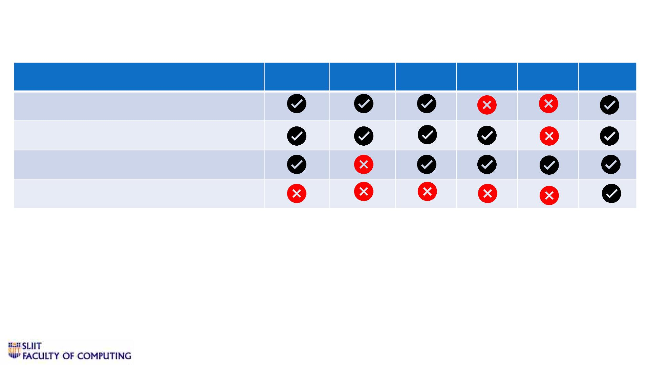
vResearch Gap
Features
A
B
C
D
E
F
Face identification
Color detection
Inbuilt voice output system
Realtime distance estimation
A - Static Hand Gesture and Face Recognition System for Blind People
B - Smartphone based face recognition tool for the blind
C - Ultrasonic smart glasses for blind
D - Intelligent eye: A mobile application for assisting blind people
E - Third Eye: An Eye for the Blind to Identify Objects Using Human-Powered Technology
F – Current Research Project and Solutions
IT19109190 | Keshara S.R.D.S. | 2022-227
11/9/2022
67

Slide 68
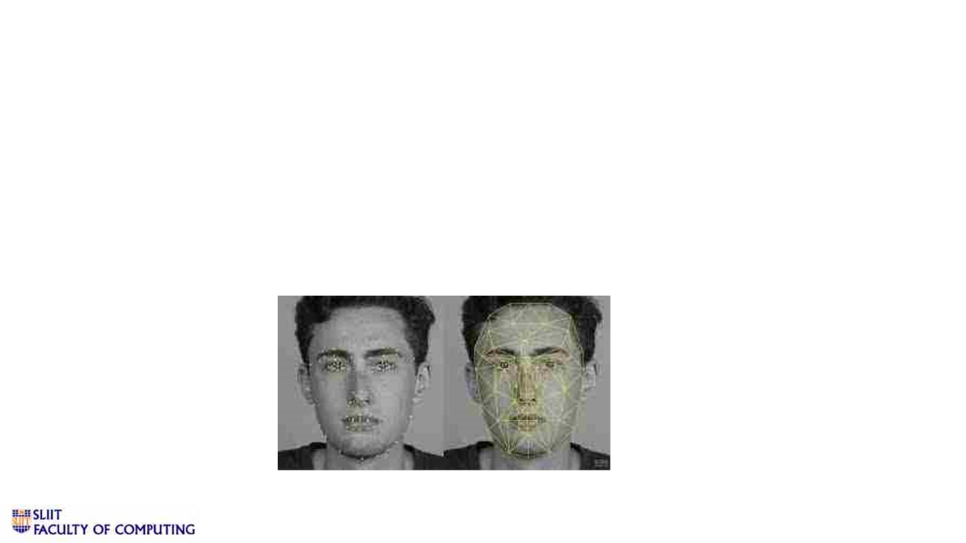
vResearch Problem
• Storage of biometric data of each known individual of the user.
• Assignment of key identifiers for individuals.
• Voice output feature to be implemented when individual is successfully
identified.
• Distance calculation between user and known individual.
• Partial face detection feature when the individual is facing the user at an
angle.
IT19109190 | Keshara S.R.D.S. | 2022-227
11/9/2022
68

Slide 69
vSpecific & sub objectives
• Specific objective
Ø Develop a face detection algorithm for known individuals of the visually impaired user so
that the user can easily locate his/her loved ones and obtain assistance when needed.
• Sub objectives
Ø Distance calculation between user and known individual.
Ø Voice confirmation of identified individual.
Ø Accurate face identification in a crowded environment.
Ø Face recognition using partial facial features.
IT19109190 | Keshara S.R.D.S. | 2022-227
11/9/2022
69

Slide 70
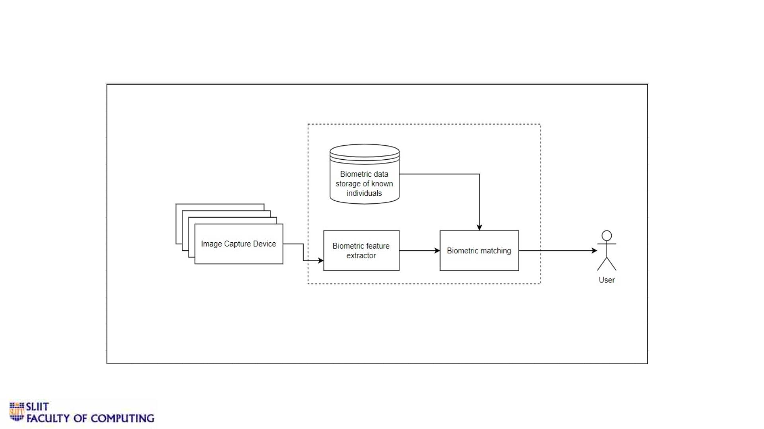
vMethodology
IT19109190 | Keshara S.R.D.S. | 2022-227
11/9/2022
70

Slide 71

vTechnologies
• Python
• OpenCV
• Yolo
• Android Studio
IT19109190 | Keshara S.R.D.S. | 2022-227
11/9/2022
71

Slide 72
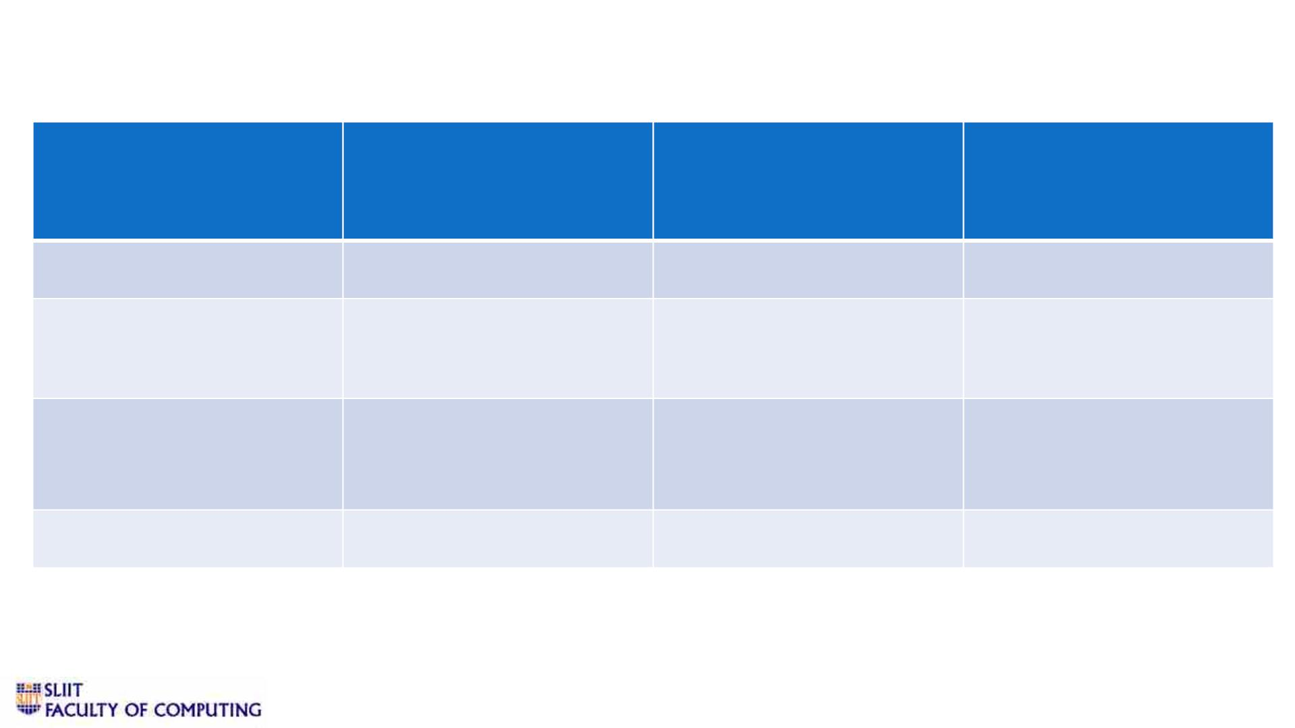
vRequirements
Functional Requirements Non-functional
Requirements
User Requirements
System Requirements
User login
Scalability
Internet Connectivity
Smart phone
High storage
Face identification of
known individuals
Performance
Camera with good
resolution & quality
Distance calculation
between user and known
person
Usability
Power supply
Pair of glasses
Microphone
User friendly
IT19109190 | Keshara S.R.D.S. | 2022-227
11/9/2022
72

Slide 73
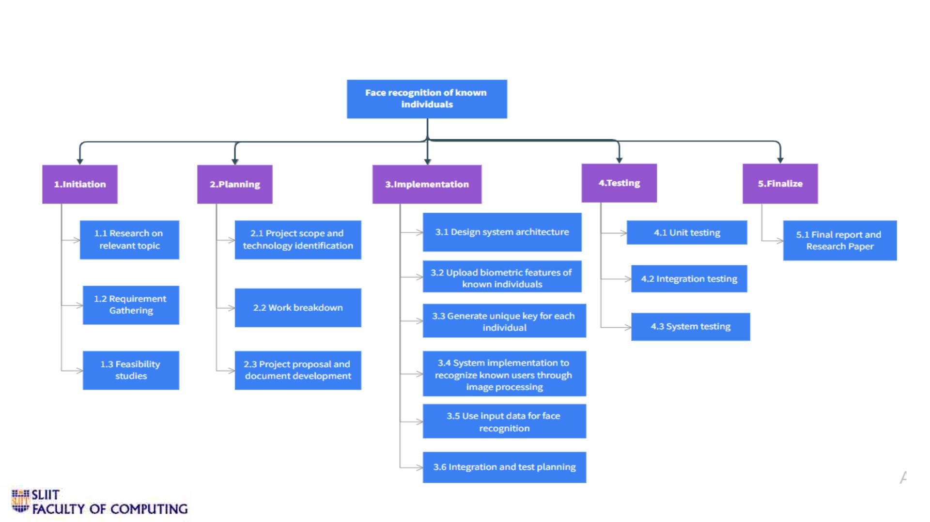
vWork breakdown structure
IT19109190 | Keshara S.R.D.S. | 2022-227
11/9/2022
73

Slide 74
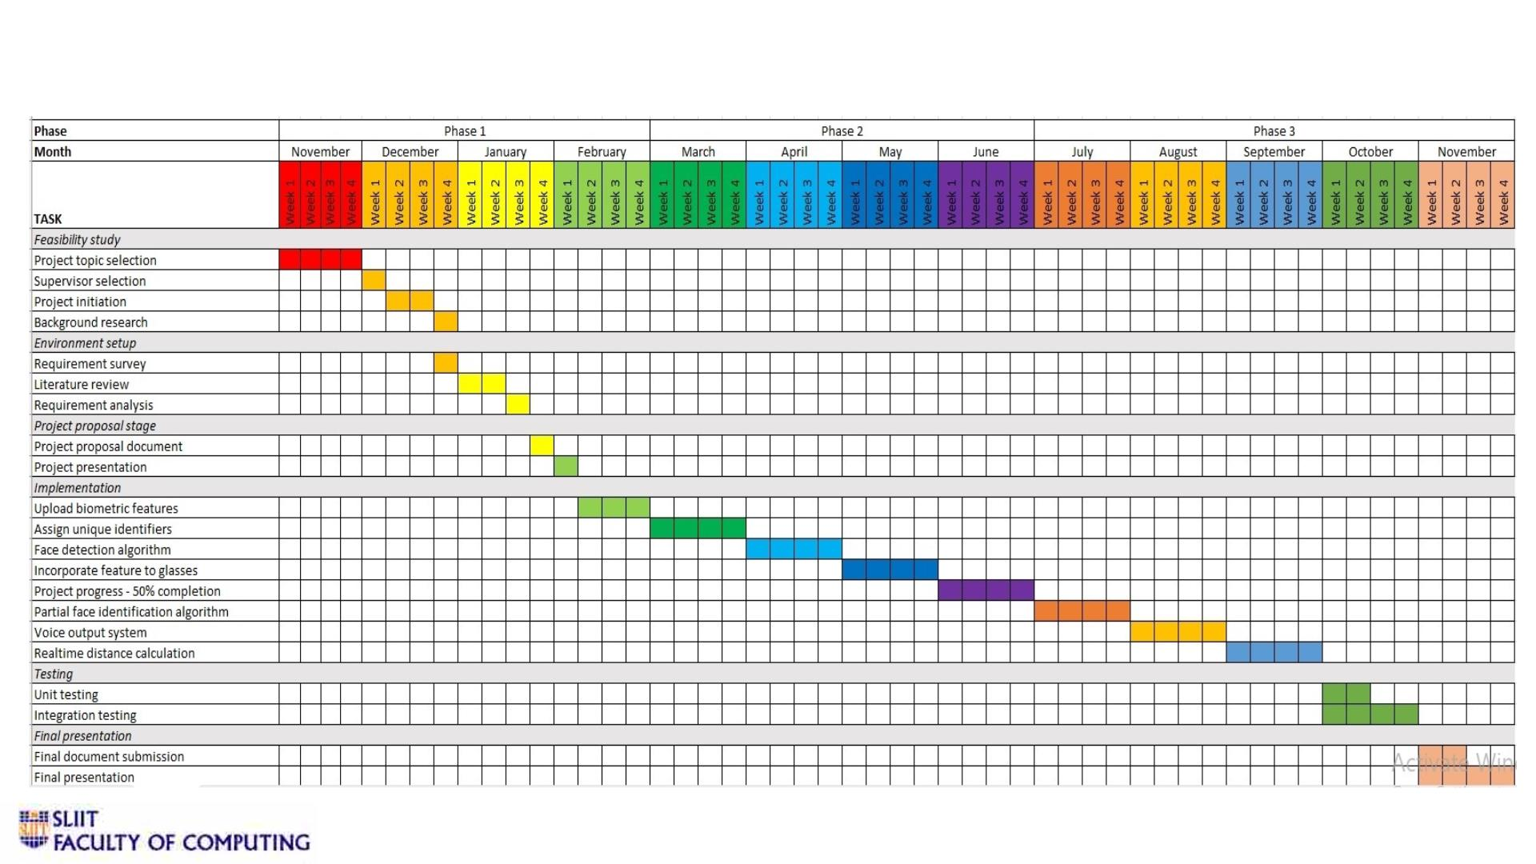
vGantt chart
IT19109190 | Keshara S.R.D.S. | 2022-227
11/9/2022
74

Slide 75
vReferences
1) Balakrishnan G, Sainarayanan G, Nagarajan R and Yaacob S. 2007. Wearable Real-Time Stereo Vision
for the Visually Impaired Engineering. [1]
2) Sharma, Saransh, and Samyak Jain. "A static hand gesture and face recognition system for blind
people." 2019 6th International Conference on Signal Processing and Integrated Networks (SPIN). IEEE,
2019. [2]
3) K. M. Kramer, D. S. Hedin and D. J. Rolkosky, "Smartphone based face recognition tool for the
blind," 2010 Annual International Conference of the IEEE Engineering in Medicine and Biology, 2010. [3]
4) R. Agarwal et al., "Low cost ultrasonic smart glasses for blind," 2017 8th IEEE Annual Information
Technology, Electronics and Mobile Communication Conference (IEMCON), 2017 [4]
5) M. Awad, J. E. Haddad, E. Khneisser, T. Mahmoud, E. Yaacoub and M. Malli, "Intelligent eye: A mobile
application for assisting blind people," 2018 IEEE Middle East and North Africa Communications
Conference (MENACOMM), 2018. [5]
6) L. Albraheem et al., "Third Eye: An Eye for the Blind to Identify Objects Using Human-Powered
Technology," 2015 International Conference on Cloud Computing (ICCC), 2015. [6]
IT19109190 | Keshara S.R.D.S. | 2022-227
11/9/2022
75

Slide 76
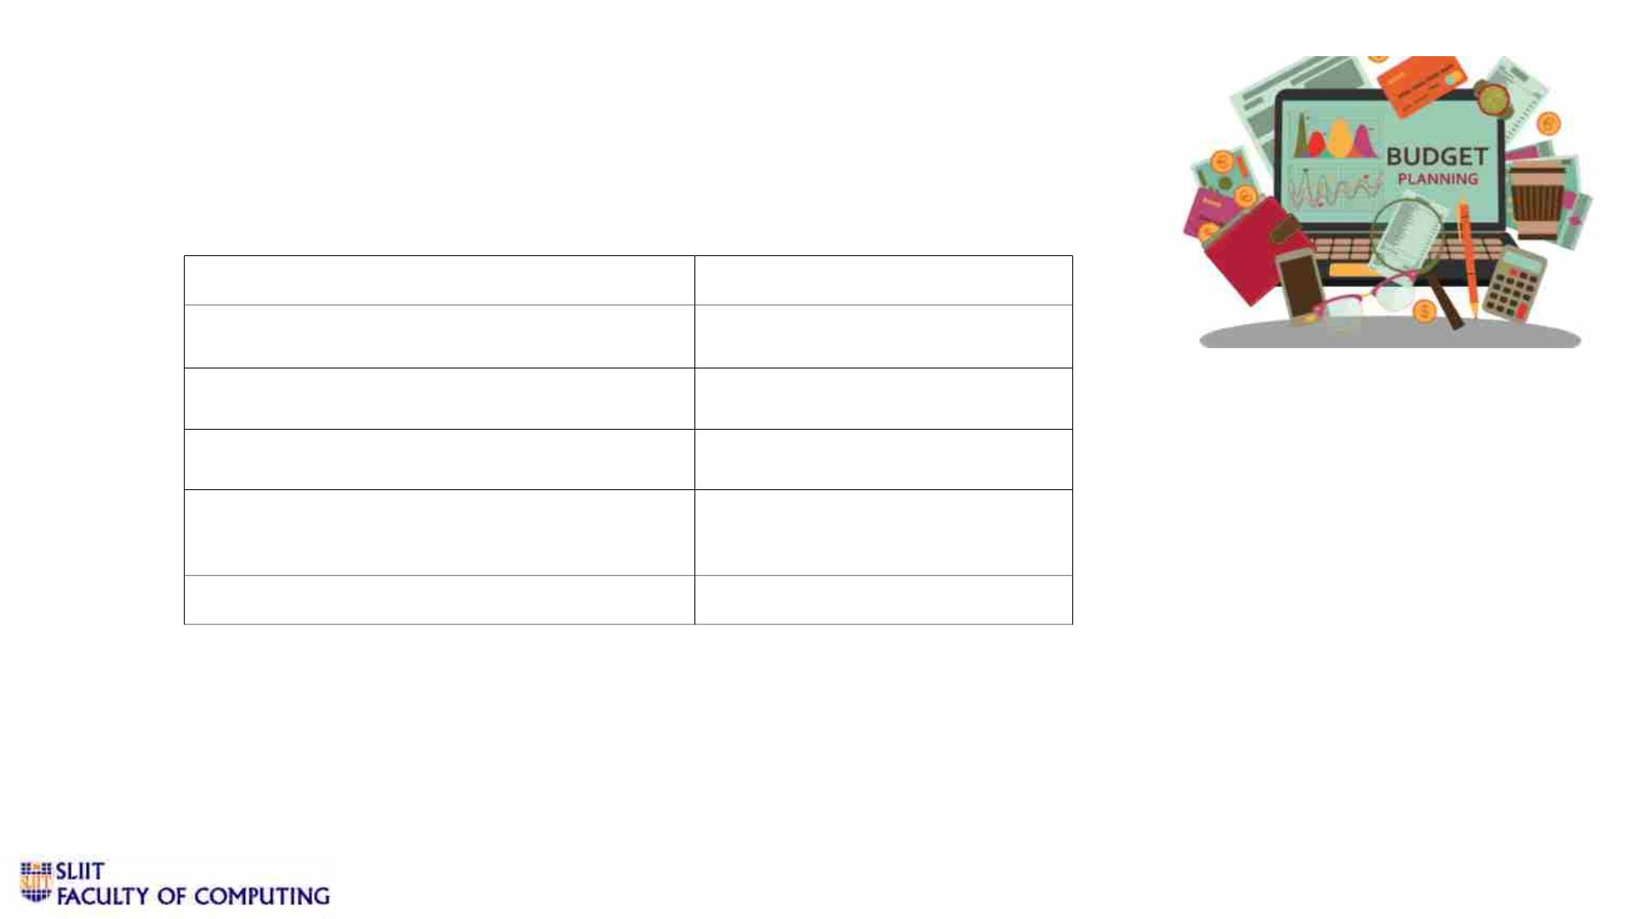
Supportive Information
v Budget
Resource Type
Internet usage for researching
Amount [LKR]
Rs. 5000
Domain name registration (annual)
Hosting (annual)
Rs. 3000
Rs. 10000
Rs. 10000
Other costs (Data Collection,
Travelling Expenses)
Total
Rs. 28000
11/9/2022
76

Slide 77
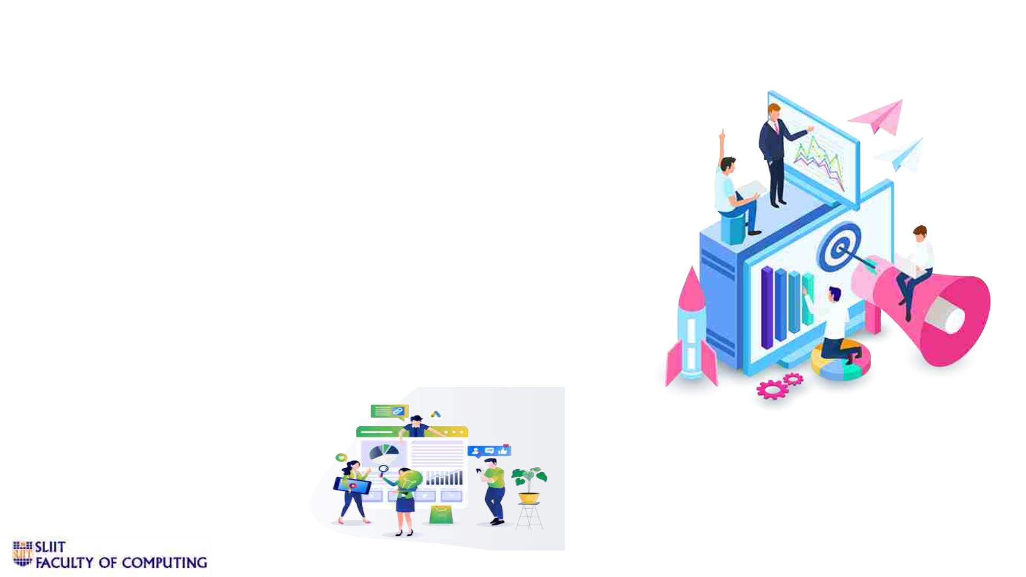
Supportive Information
v Commercialization
• Identifying the target audiences.
• Create social media and flyer marketing plan in SLIIT.
• Advertise on course web and other social medias.
• Develop a pricing strategy after a year of product release.
• Send e-mail to SLIIT students about the application.
11/9/2022
77

Slide 78

11/9/2022
78

